Slide 1
Introduction to Deep Learning in Biology
Justin Vrana, PHD Candidate
Klavins Lab
Tuesday, May 27, 2019

Slide 2
References for Deep Learning
Deep Learning, Ian Goodfellow (2014) [there’s a free online version]
Complete academic reference for deep learning. Includes primer on linear algebra and machine learning
Hands-On Machine Learning with Scikit-Learn & TensorFlow, Aurelien Geron (2017)
https://www.oreilly.com/library/view/hands-on-machine-learning/9781491962282/
The Matrix Cookbook, Pedersen & Petersen (2012)
https://www.math.uwaterloo.ca/~hwolkowi/matrixcookbook.pdf
IntroToDeepLearning.com
MIT course with online material and slides
Online Tutorials:
3Blue1Brown Online Video Series: https://www.youtube.com/playlist?list=PLZHQObOWTQDNU6R1_67000Dx_ZCJB-3pi
Pytorch https://pytorch.org/tutorials/
TensorFlow: https://www.tensorflow.org/tutorials

Slide 3


Slide 4
Techniques to mimic human intelligence
The ability to learn without be explicitly programmed (often statistical)
Extracting features from raw data

Slide 5
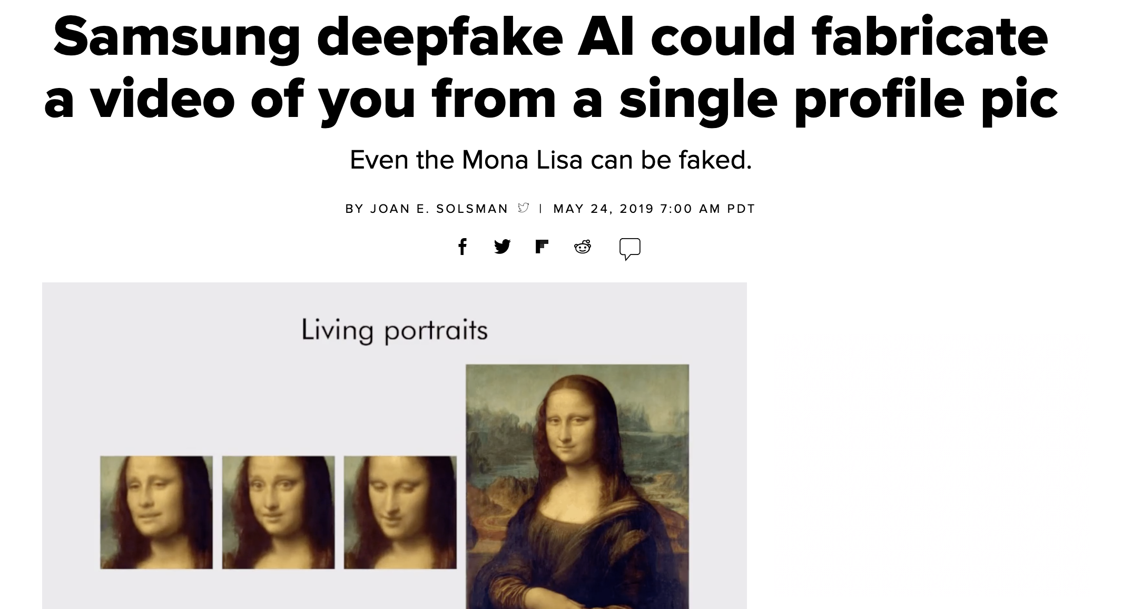
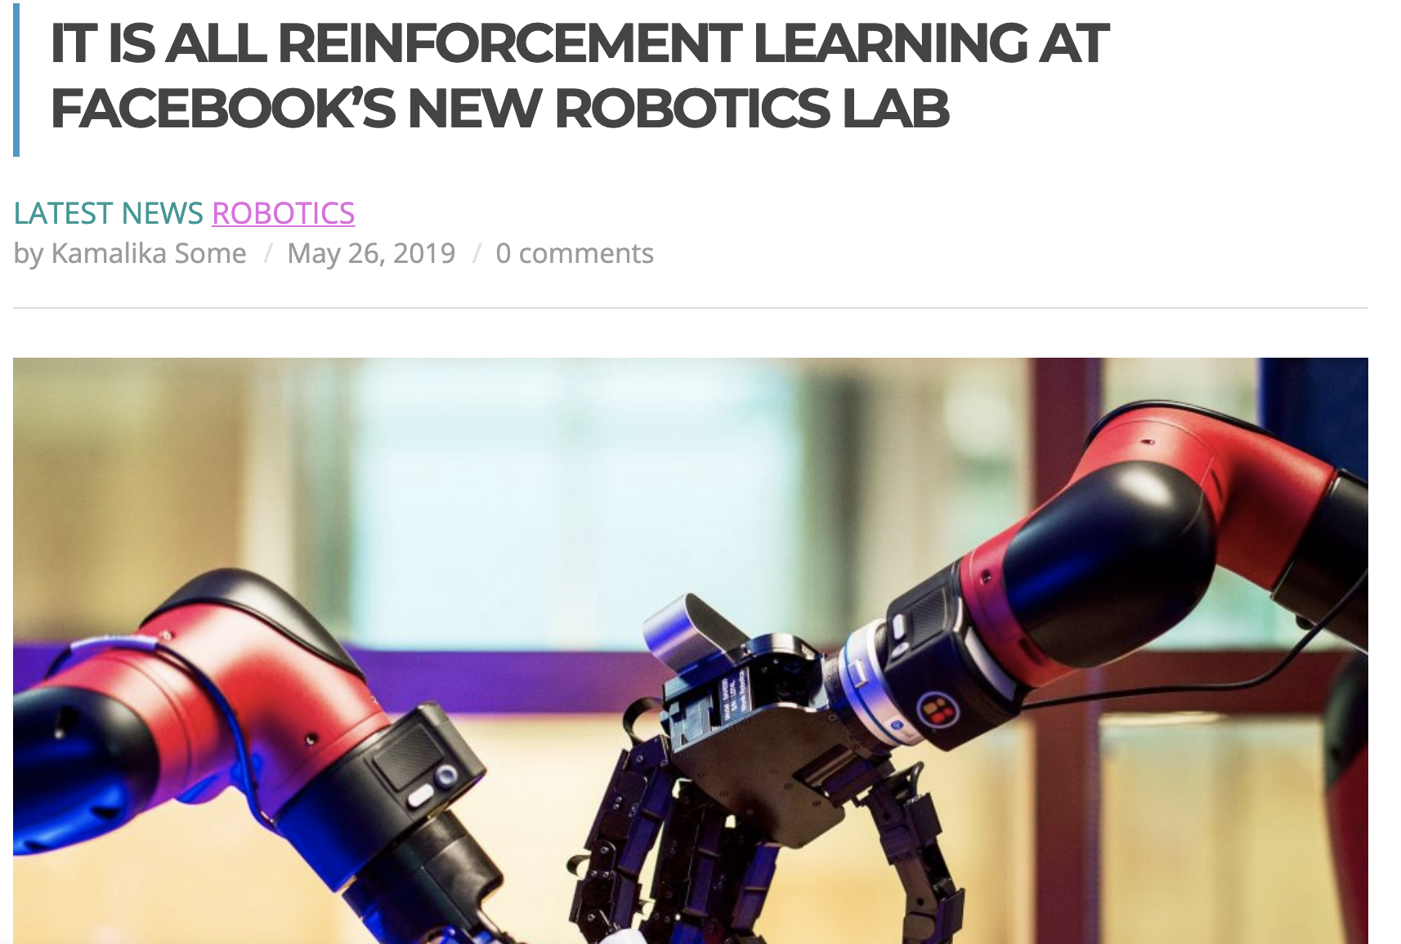
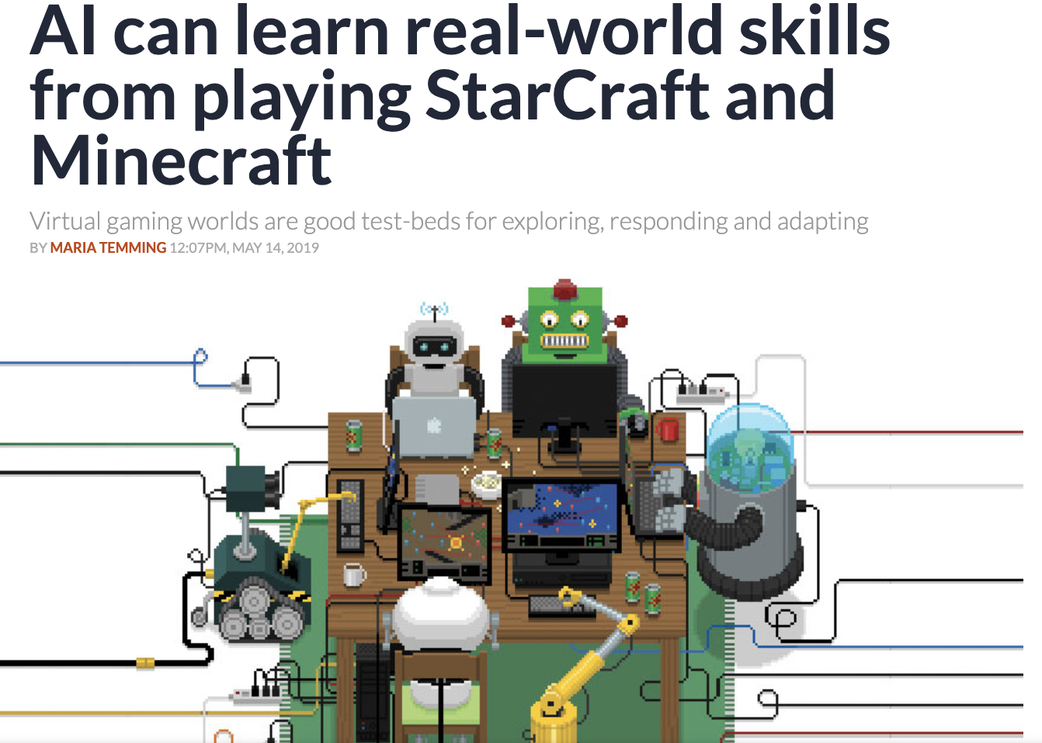
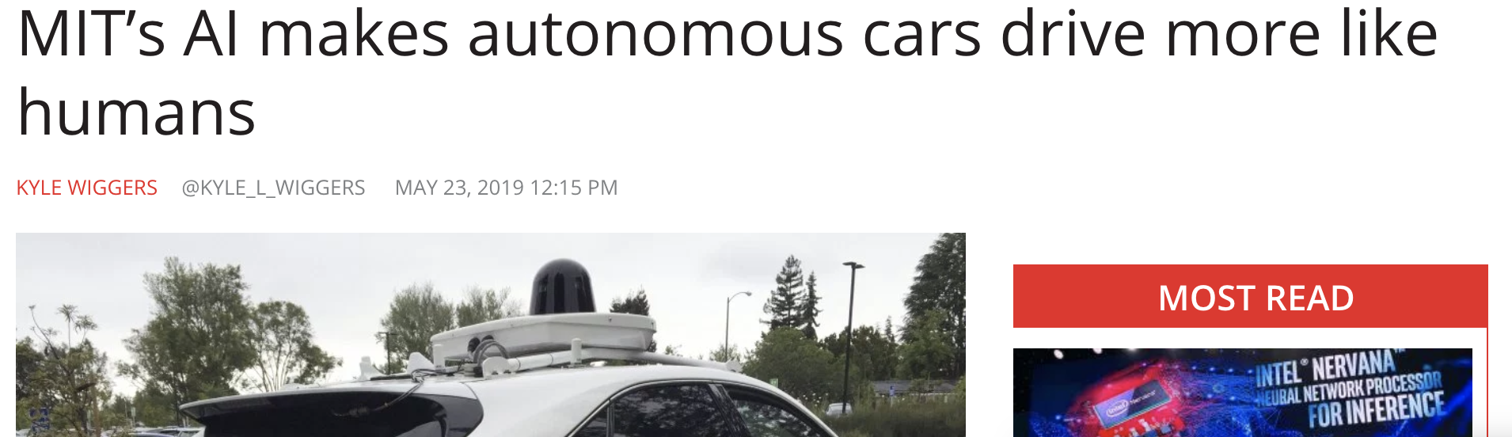
Where is Deep Learning Used?

Slide 6
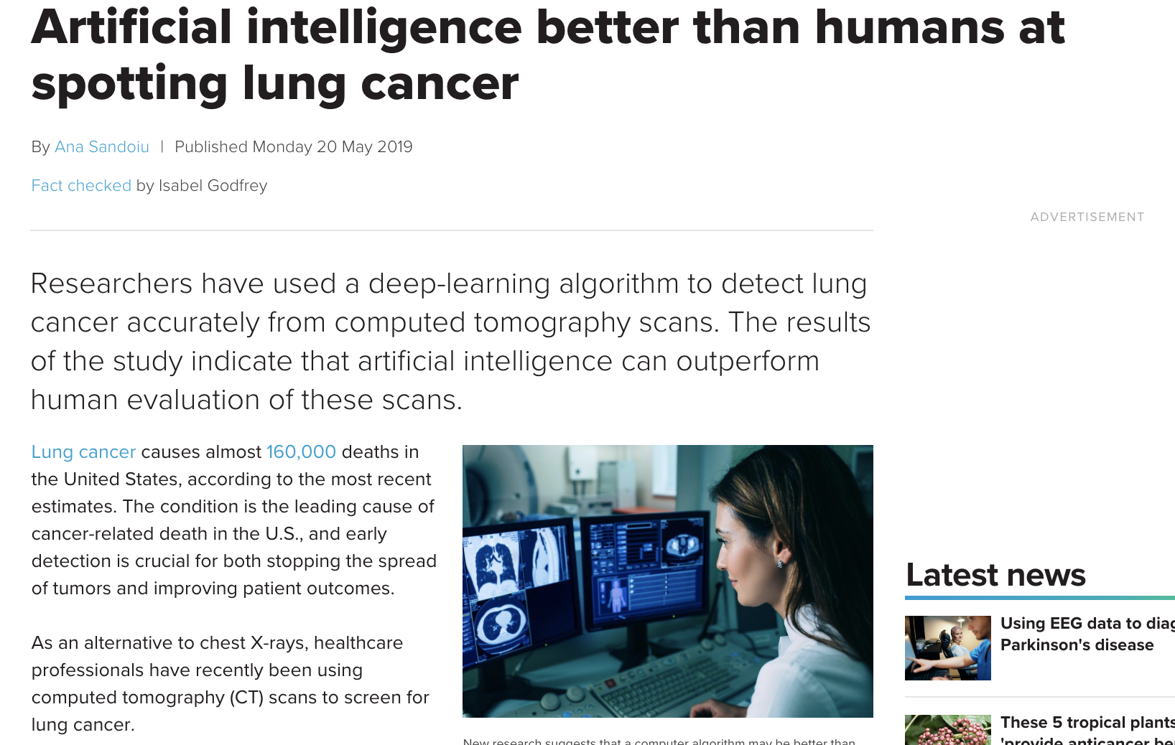
Deep Learning in Medicine and Biology

Slide 7
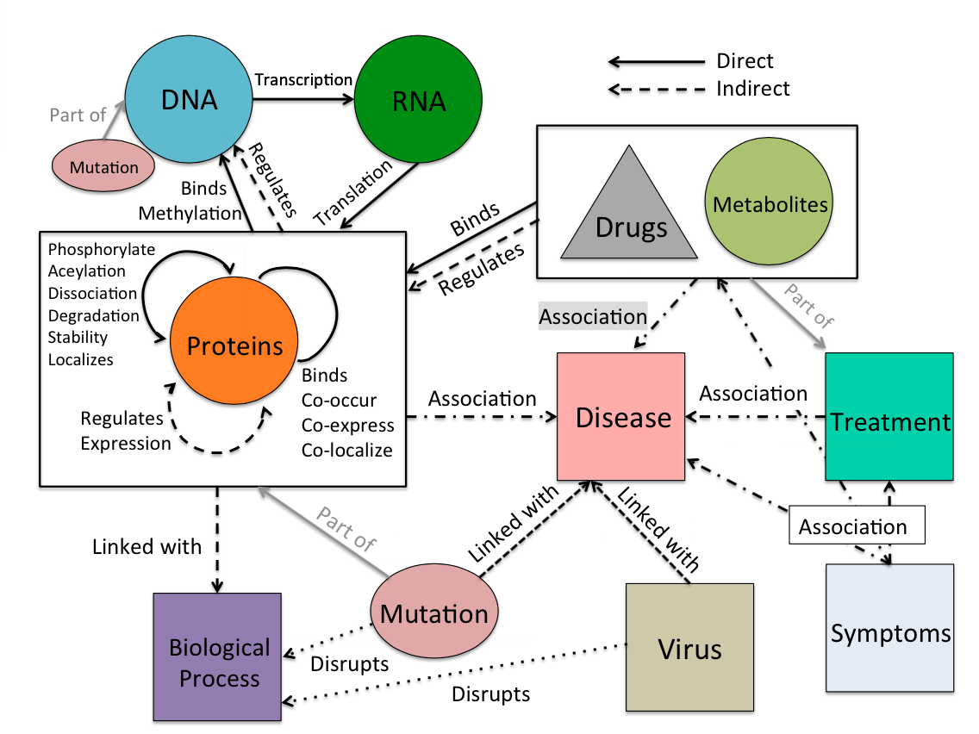
Examples of Deep Learning in Chemistry/Biology

Slide 8
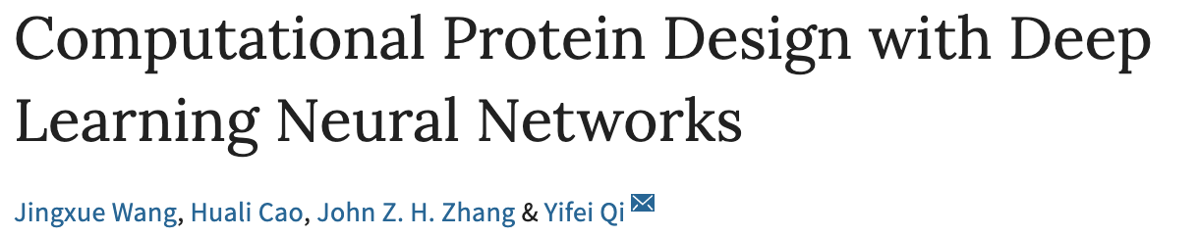
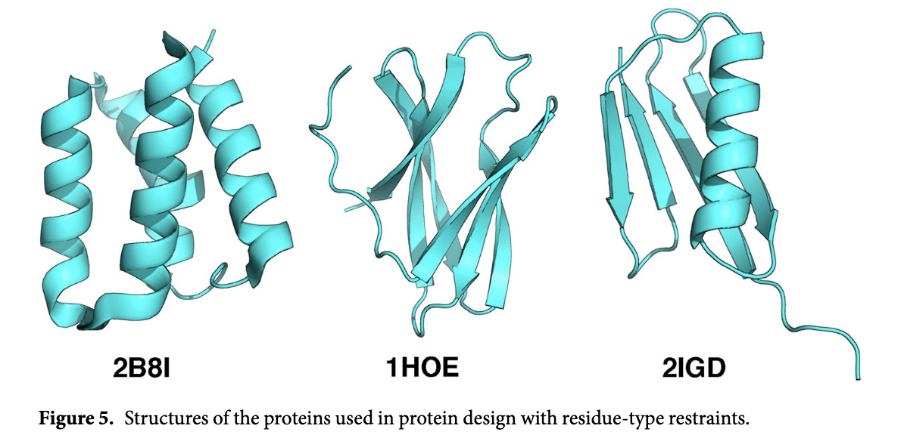
Notes:
In this study, we applied the deep learning neural network approach to computational protein design for predicting the probability of 20 natural amino acids on each residue in a protein. A large set of protein structures was collected and a multi-layer neural network was constructed. A number of structural properties were extracted as input features and the best network achieved an accuracy of 37.9%. Using the network output as residue type restraints was able to improve the average sequence identity in designing three natural proteins using Rosetta. Moreover, the predictions from our network show better sequence identity than a previous method. Results from this study may benefit further development of computational protein design methods.

Slide 9
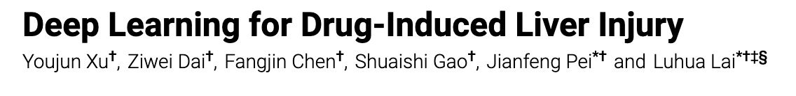
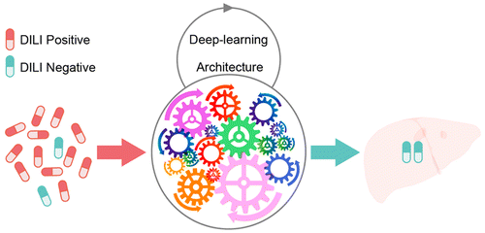
Notes:
Molecular descriptors to probability that drug would damage liver

Slide 10
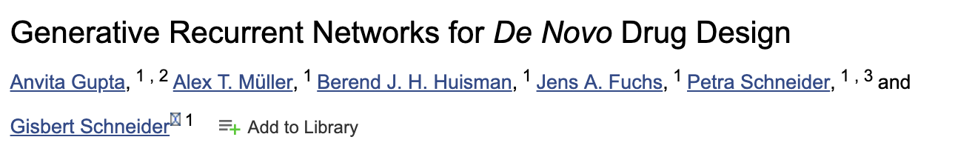
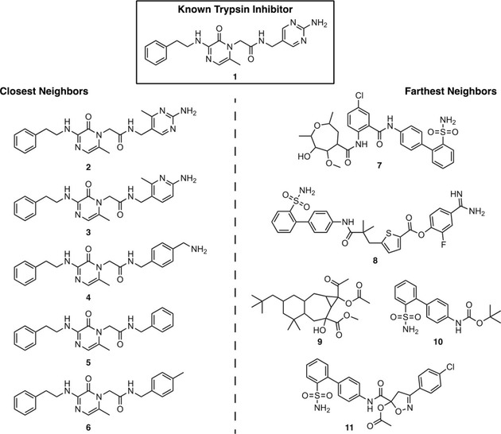

Slide 11
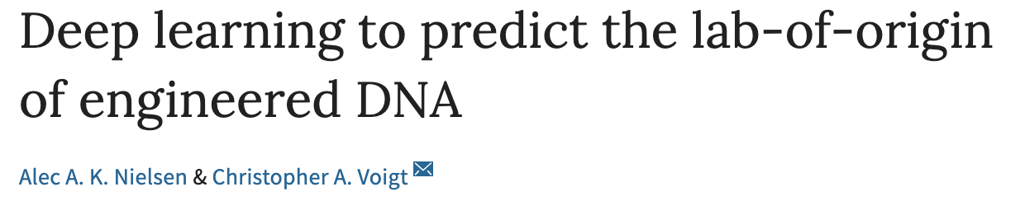
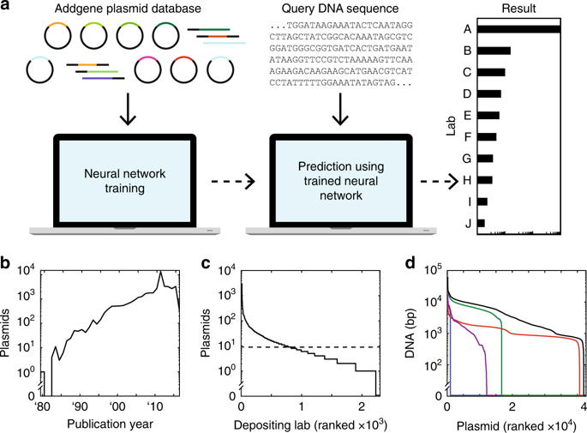

Slide 12
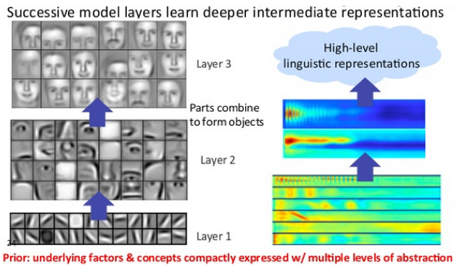
Deep Learning extracts Features from Data
Face
Nose/Eyes
Lines/Edges
Notes:
Lines and edges >>

Slide 13
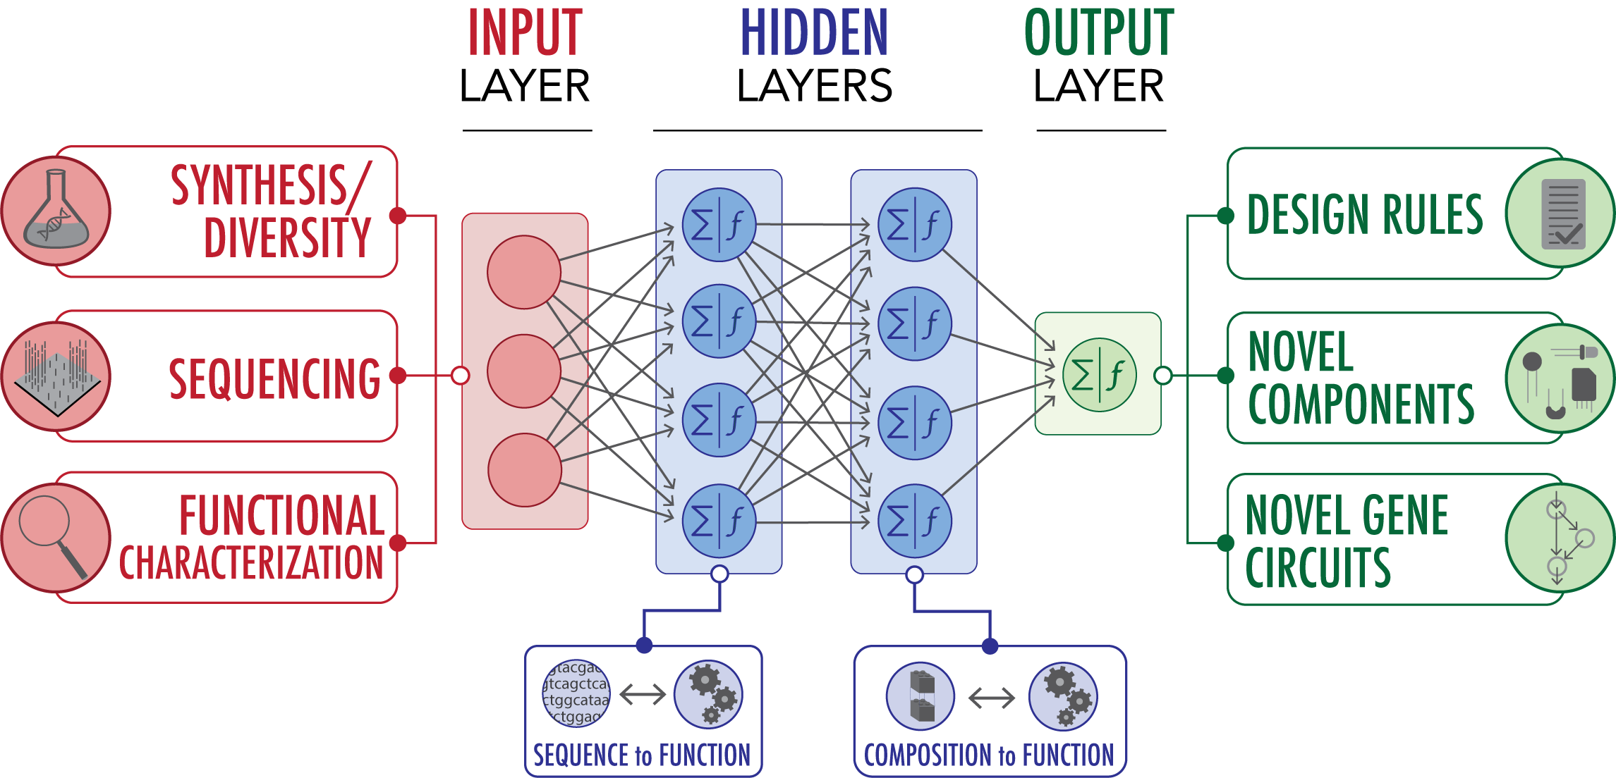
Grand Challenge: Machine Design of Cells and Cell Behaviors from ‘Parts’
Image from Jim Collins

Slide 14
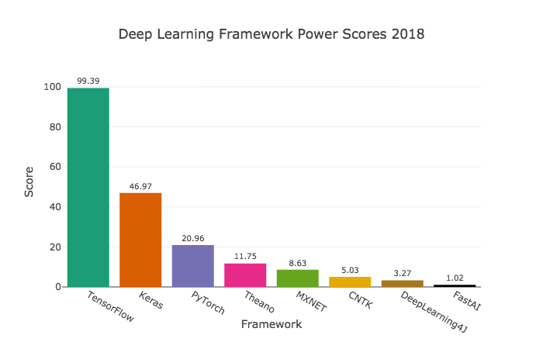
Python Frameworks for Deep Learning

Slide 15

Python Frameworks for Deep Learning

Slide 16
Demystifying Neural Networks

Slide 17
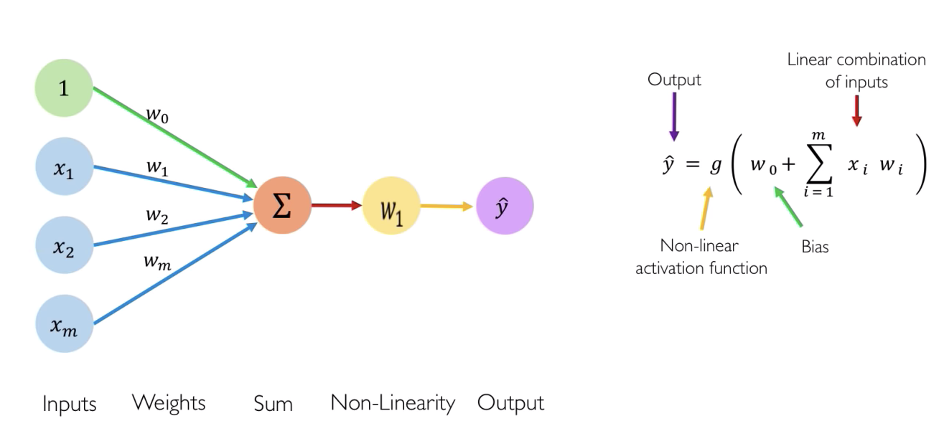
Perceptron/Neuron: Forward Propagation

Slide 18
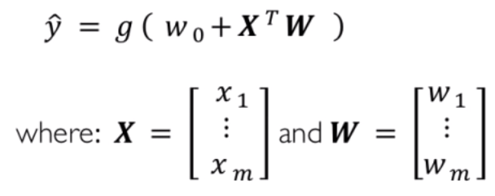

Slide 19
There are always just 3 steps to a perceptron:
Dot-product between weights (W) and inputs (X)
Adding a bias (w0)
Applying to an activation function

Slide 20
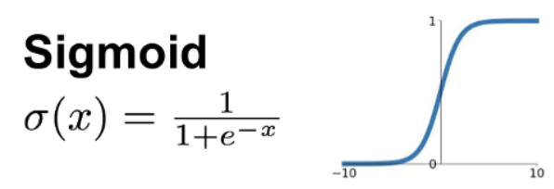
Activation Function:

Slide 21

Activation Functions: Introducing Non-Linearity

Slide 22
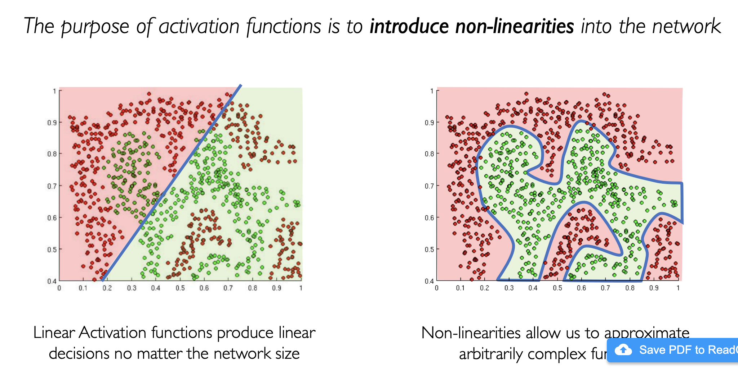
Why do we need non-linearity?
© MIT 6.S191: Introduction to Deep Learning introtodeeplearning.com

Slide 23
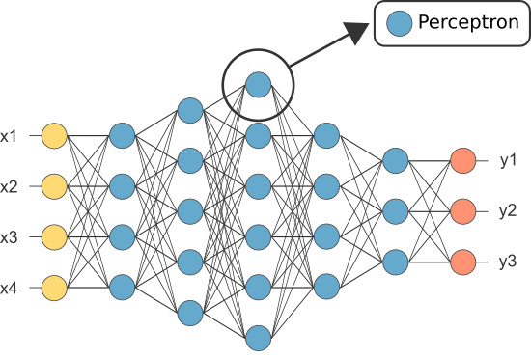
The Multi-Layer Perceptron
Perceptron

Slide 24
The Multi-Layer Perceptron (i.e. Deep NN)
Input Layer
Hidden Layer
Output Layer

Slide 25
The Multi-Layer Perceptron
Fwd Prop: Same Steps!
Weight times input
Bias
Activation fxn

Slide 26
The Training Process

Slide 27
Fake Example: Citation Prediction
Data: Bunch of scholarly articles
Goal: Predict the number of citations a paper will have based on the authors and contents.
Data Features: [What do you think these would be?]

Slide 28
Fake Example: Citation Prediction
Data: Bunch of scholarly articles
Goal: Predict the number of citations a paper will have based on the authors and contents.
Data Features: Authors, Some keywords in title, length of title, which journal published, article length

Slide 29
Fake Example: Citation Prediction
Data: Bunch of scholarly articles
Goal: Predict the number of citations a paper will have based on the authors and contents.
Data Features: Authors, keywords, length of title, which journal published, article length, etc.

Slide 30
Fake Example: Citation Prediction
Data: Table of title lengths and how many citations within the first 3 years of publication
Binning Title Lengths
[1, 0, 0]
< 5 5-10 >10

Slide 31
Fake Example: Citation Prediction
x
y
X: Title Lengths
[1, 0, 0]
< 5 5-10 >10

Slide 32
Fake Example: Citation Prediction
x
y
X: Title Lengths
y: Number of citations
[1, 0, 0]
< 5 5-10 >10
Hidden layers

Slide 33
Fake Example: Citation Prediction
[1, 0, 0]
Output: 1
< 5 5-10 >10

Slide 34
Fake Example: Citation Prediction
[1, 0, 0]
Output: 1
Actual: 25
< 5 5-10 >10

Slide 35
Fake Example: Citation Prediction
[1, 0, 0]
Output: 1
Actual: 25
< 5 5-10 >10
So what happened?

Slide 36
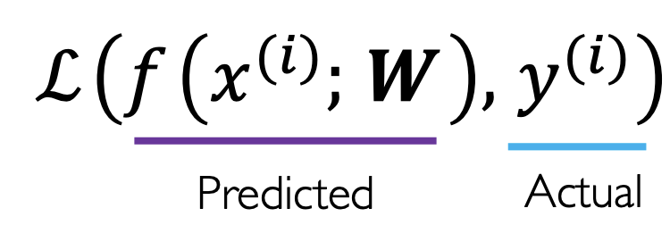
The Loss Function
[1, 0, 0]
Output: 1
Actual: 25
< 5 5-10 >10

Slide 37
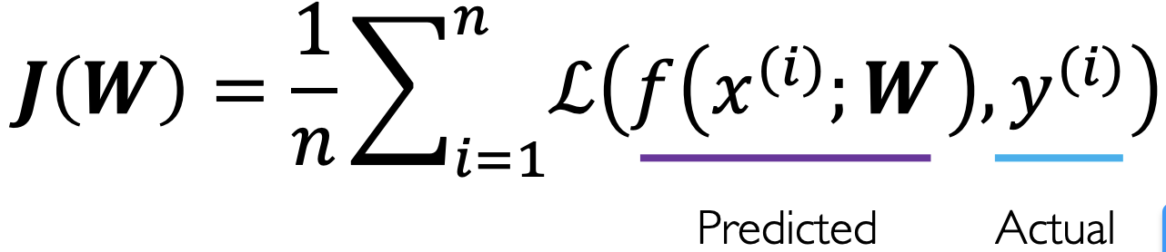
The Empirical Loss Function
Empirical loss sums loss over all of the data
f(x)
y
[1, 0, 0]
[0, 1, 0]
[1, 0, 0]
[0, 0, 1]
[0, 0, 1]
…
201
18
1
2
50
…
101
13
43
23
542
…
X =

Slide 38
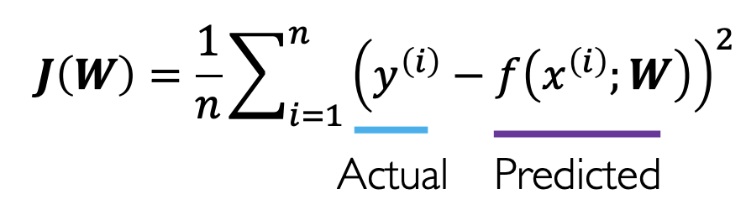
Mean Squared Entropy (MSE)
Mean Squared Entropy can be used for regression
f(x)
y
[1, 0, 0]
[0, 1, 0]
[1, 0, 0]
[0, 0, 1]
[0, 0, 1]
…
201
18
1
2
50
…
101
13
43
23
542
…
X =

Slide 39
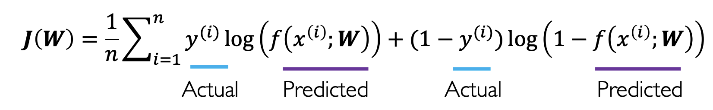
Binary Cross Entropy Loss
Binary cross entropy is used for probabilities between 0 and 1
f(x)
y
[1, 0, 0]
[0, 1, 0]
[1, 0, 0]
[0, 0, 1]
0.4
0.2
0.1
1.0
1
0
0
0
X =

Slide 40
Optimizing the Loss Function
The goal is to find the weights and biases with the lowest loss
Notes:
Loss of what?

Slide 41
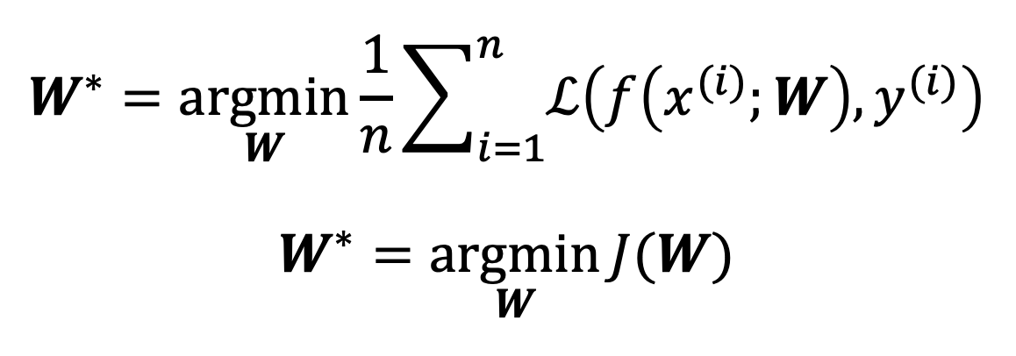
Minimizing the Loss Function
The goal is to find the weights and biases with the lowest loss
Notes:
Loss of what?

Slide 42
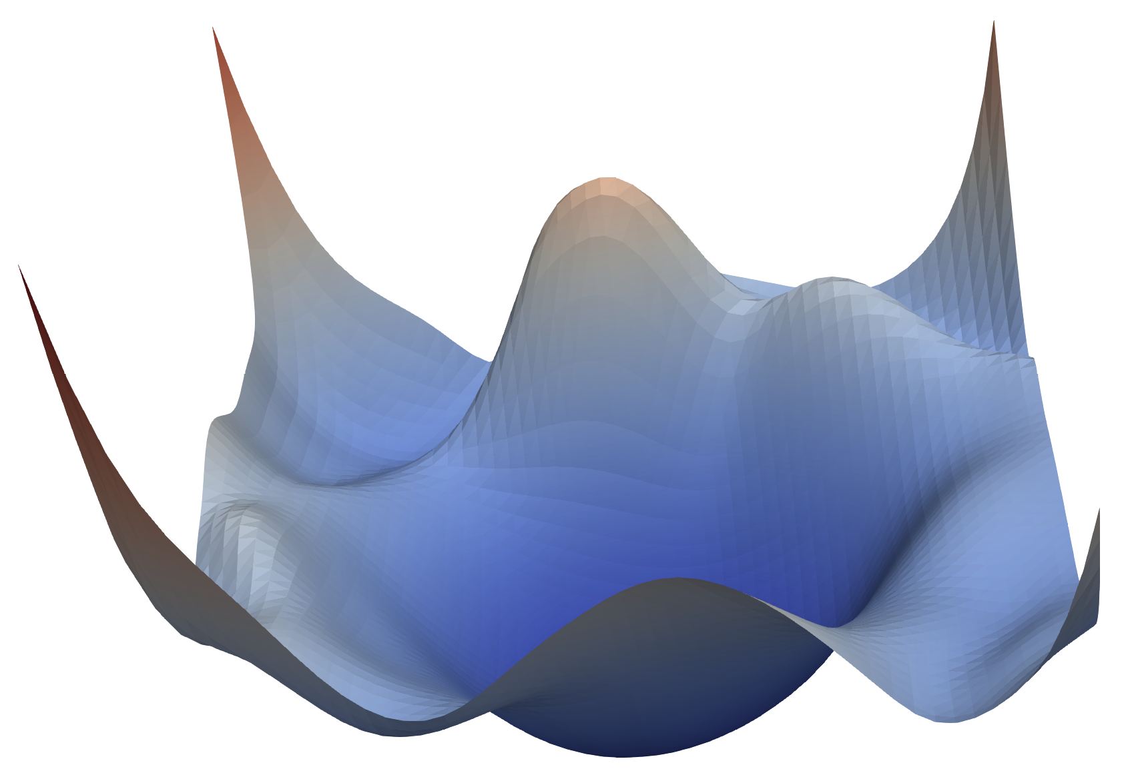
Loss Landscape
Visualizing the Loss Landscapes of Neural Nets, 2017 https://arxiv.org/abs/1712.09913

Slide 43
Loss Landscape
1. Pick random weights
Visualizing the Loss Landscapes of Neural Nets, 2017 https://arxiv.org/abs/1712.09913

Slide 44
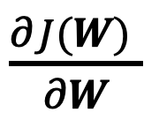
Loss Landscape
Pick random weights
Compute the gradient
Visualizing the Loss Landscapes of Neural Nets, 2017 https://arxiv.org/abs/1712.09913

Slide 45
Loss Landscape
Pick random weights
Compute the gradient
Take small step down, GOTO 2
Visualizing the Loss Landscapes of Neural Nets, 2017 https://arxiv.org/abs/1712.09913

Slide 46

Loss Landscape
Pick random weights
Compute the gradient
Take small step down, GOTO 2
Visualizing the Loss Landscapes of Neural Nets, 2017 https://arxiv.org/abs/1712.09913

Slide 47
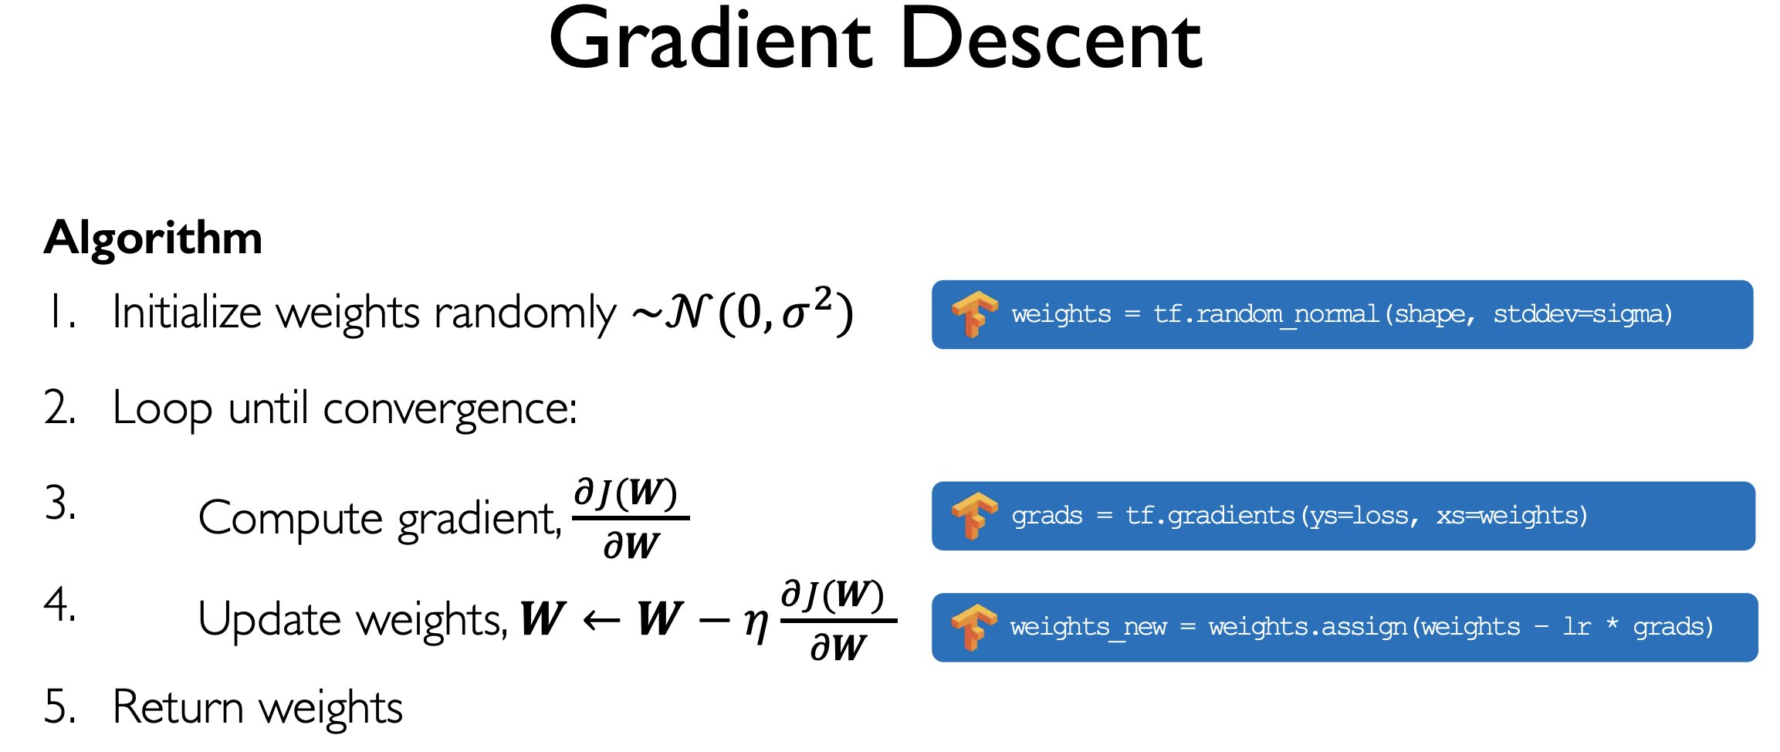
© MIT 6.S191: Introduction to Deep Learning introtodeeplearning.com

Slide 48
© MIT 6.S191: Introduction to Deep Learning introtodeeplearning.com

Slide 49
Back Propagation
How do the weights here
…contribute to the loss here?

Slide 50
Back Propagation
…contribute to the final loss J(W) here?
How do the weights here

Slide 51
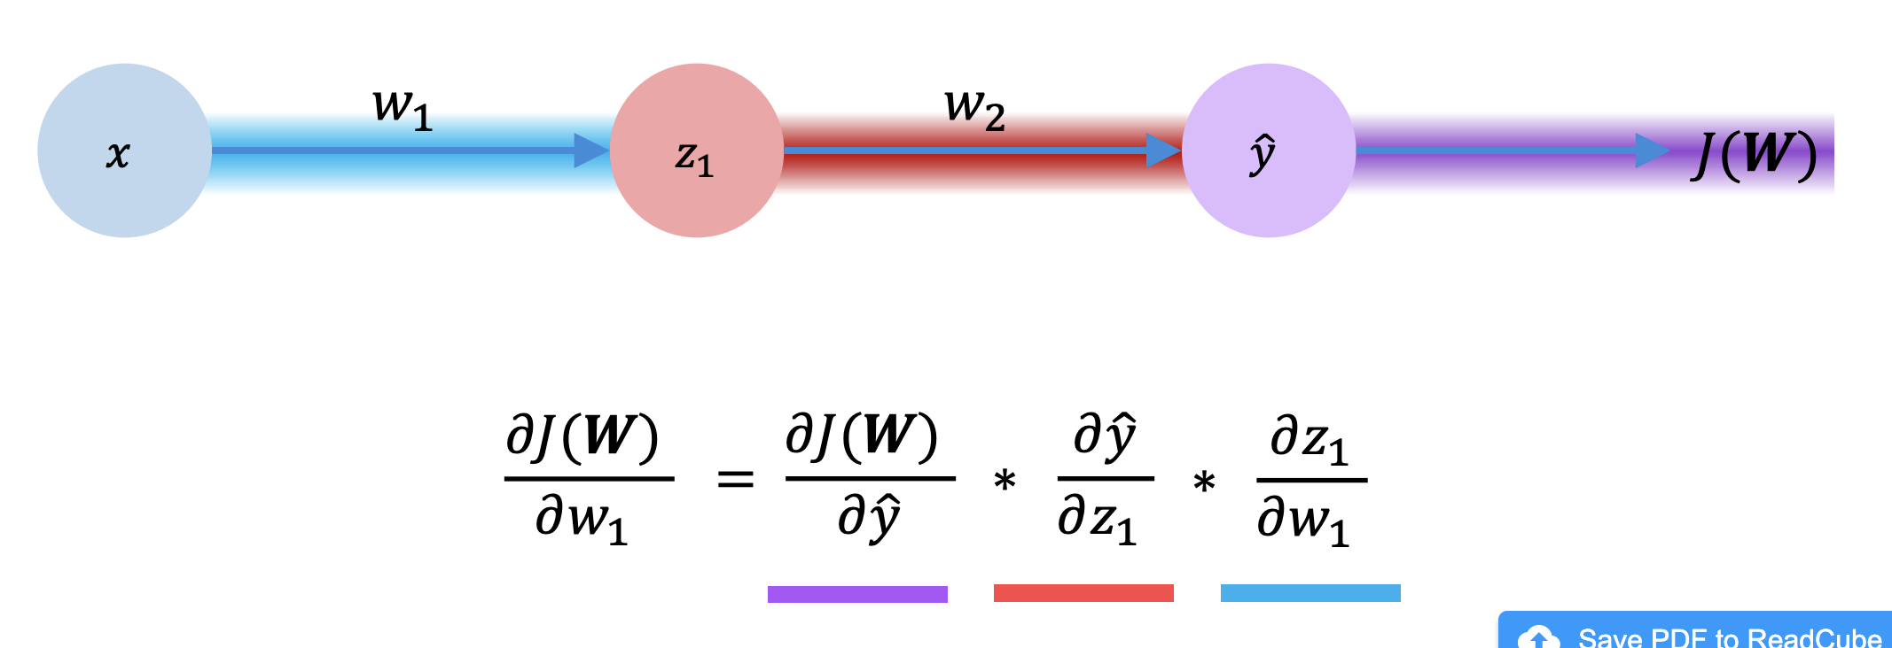
Back Propagation
https://www.youtube.com/watch?v=Ilg3gGewQ5U
© MIT 6.S191: Introduction to Deep Learning introtodeeplearning.com

Slide 52
Back Propagation
© MIT 6.S191: Introduction to Deep Learning introtodeeplearning.com

Slide 53
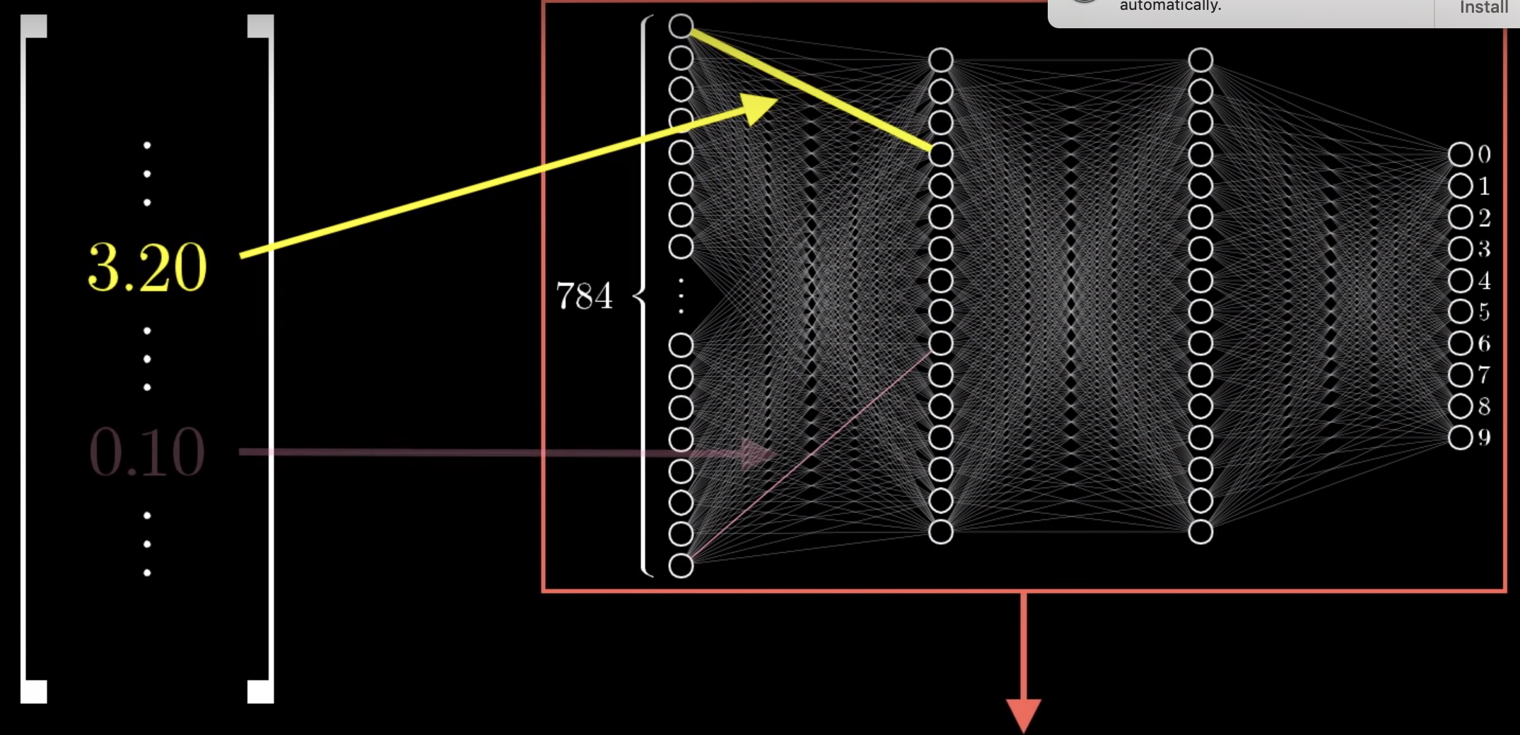
Back Propagation

Slide 54
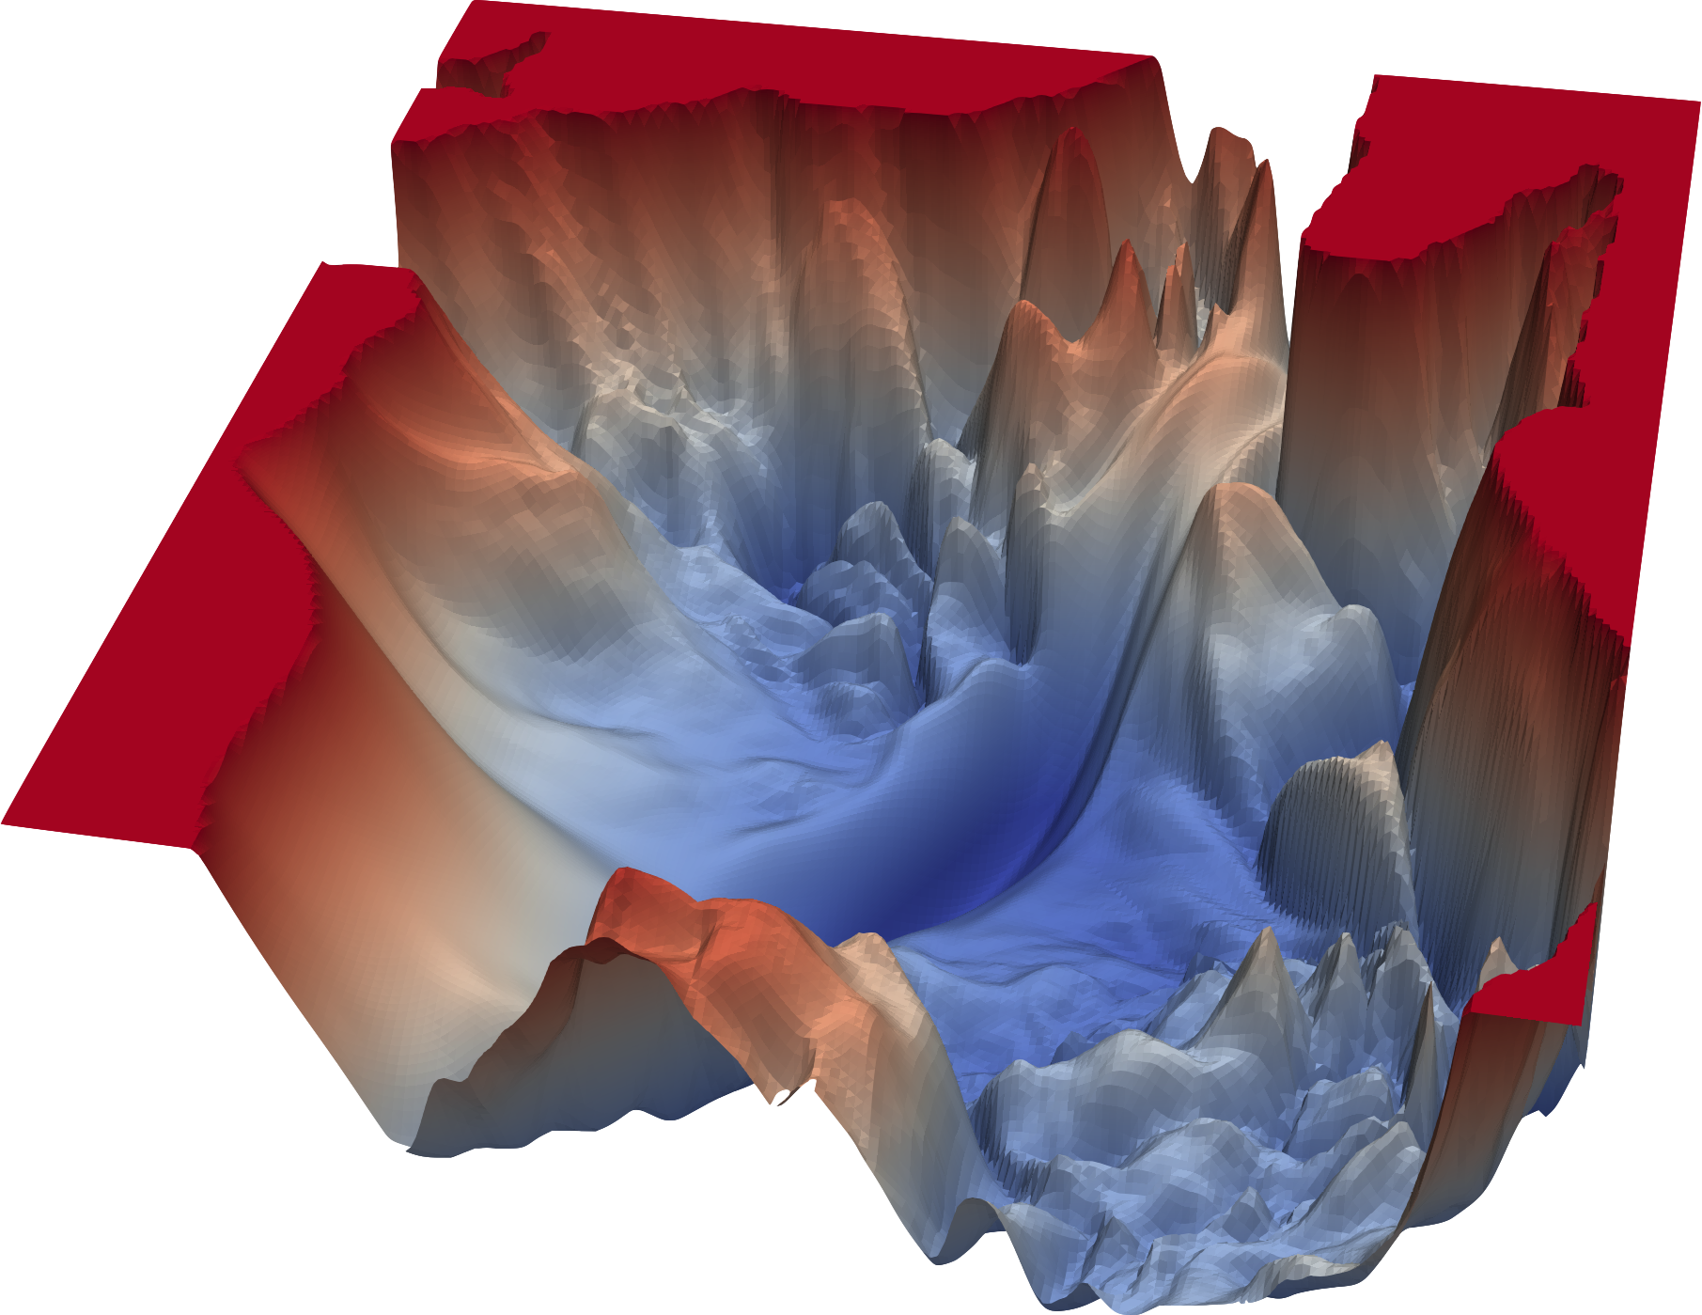
Some minima are hard to find
How big of steps η should we take?
Visualizing the Loss Landscapes of Neural Nets, 2017 https://arxiv.org/abs/1712.09913

Slide 55

Adaptive Loss Function Optimizers
Adam
Adagrad
Adadelta
Momentum
RMSProp
http://ruder.io/optimizing-gradient-descent/
Notes:
Loss of what?

Slide 56
Back to Activation Functions
http://ruder.io/optimizing-gradient-descent/
Notes:
Loss of what?

Slide 57
Back to Activation Functions
What are some issues you could see with some of there functions during the optimization process?
http://ruder.io/optimizing-gradient-descent/
Notes:
Loss of what?

Slide 58
Back to Activation Functions
What are some issues you could see with some of there functions during the optimization process?
Derivative of 0 results in vanishing gradients
If NN too big, we can get exploding gradients
http://ruder.io/optimizing-gradient-descent/
Notes:
Loss of what?

Slide 59
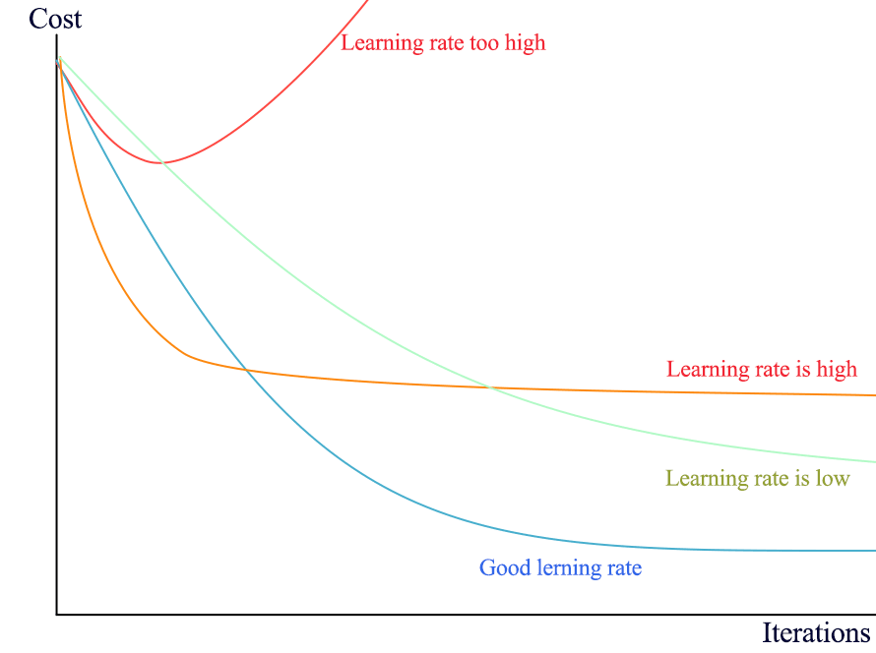
Back to Activation Functions
What are some issues you could see with some of there functions during the optimization process?
Derivative of 0 results in vanishing gradients
If NN too big, we can get exploding gradients
http://ruder.io/optimizing-gradient-descent/
Notes:
Loss of what?

Slide 60
Overfitting and Regularization

Slide 61

Overfitting

Slide 62
Measuring the ‘fit’: training vs test data
The real goal is predictive power not just loss on training data
To do this, we randomly reserve a portion of training data and anonymize the target/output data to create test data.
Epoch (Training Cycle): We train the network with the all of the training (minus the test) data (epoch). We separately evaluate the loss on the reserved test data. We repeat for many epochs.

Slide 63
Large vs Small Networks
Large networks:
Computationally expensive
Richer features
Prone to overfitting
Small networks:
Computationally cheap
‘flat’ features
Prone to underfitting

Slide 64
Large vs Small Networks
Architecture impacts best learning rate
Large networks:
Computationally expensive
Richer features
Prone to overfitting
Small networks:
Computationally cheap
‘flat’ features
Prone to underfitting

Slide 65
Regularization
Regularization is a set of techniques to decrease model complexity
Regularization helps prevent model overfitting

Slide 66
Regularization: Dropout
Dropout is when you randomly ‘destroy’ the activation function of some neurons on each epoch
Network is forced to adapt rest of network.
No single node is important
Typically 10-50% dropout rate

Slide 67
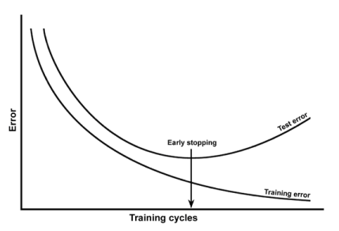
Regularization: Early Stopping
Stop training early to prevent memorization/overfitting

Slide 68
Regularization: Early Stopping
Stop training early to prevent memorization/overfitting

Slide 69
Regularization: Early Stopping
Stop training early to prevent memorization/overfitting
Underfitting
Overfitting

Slide 70
Back to the Citation Example: Expanding the Features and Model
More data features means input layer should be larger
More complex data may mean larger hidden layers or more hidden layers
Sometimes, there is nothing to learn
Other features?
???

Slide 71
Expanding the Features and Model
More data features means input layer should be larger
More complex data may mean larger hidden layers or more hidden layers
Sometimes, there is nothing to learn
Other features?
Author list
Number of authors
Past history of publishing
Journal published

Slide 72
Expanding the Features and Model
More data features means input layer should be larger
More complex data may mean larger hidden layers or more hidden layers
Sometimes, there is nothing to learn
Other features?
Author list
Number of authors
Past history of publishing
Journal published
Authorship interactions? (Need new architecture)

Slide 73
The Training Process Summary
Preprocess
Build Model
Training
Collect data
Preprocess data for N.N. (features)
Test Data %
Num inputs = features size
Hidden/Output layer size and number
Activation functions
Regularization?
Choose batch size?
Monitor test loss during epochs
Optimization func?

Slide 74
TensorFlow Tutorial

Slide 75
Python Frameworks for Deep Learning

Slide 76
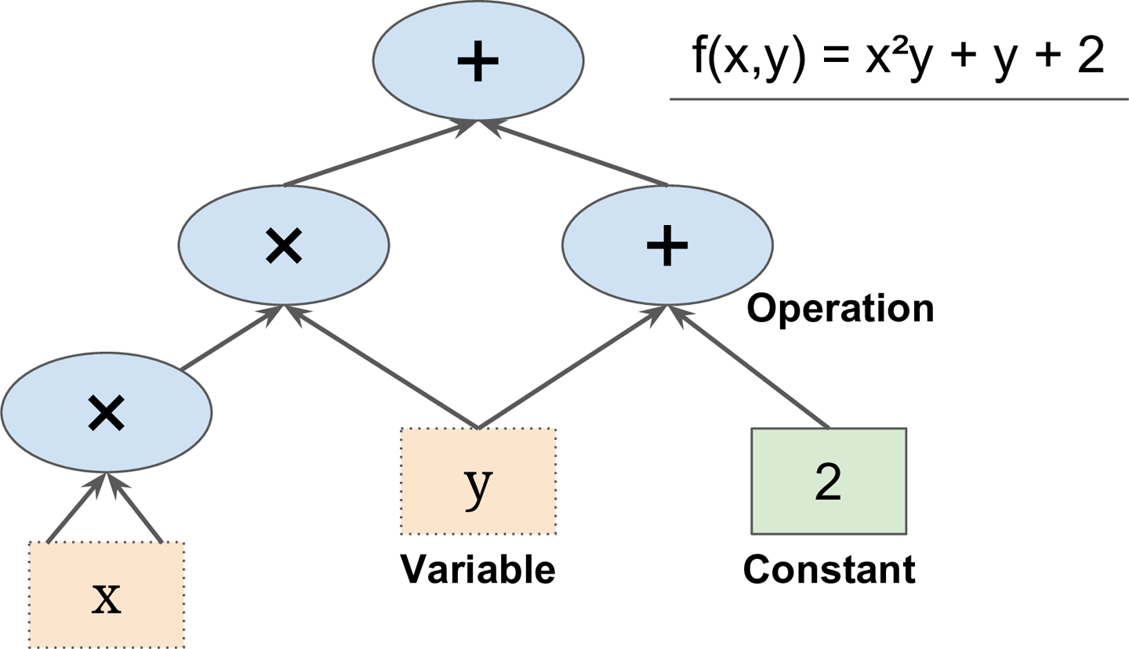
What does TensorFlow do?
TensorFlow is a open source (Google) library for numerical computation

Slide 77

Tensorflow Efficiently Computes Gradients

Slide 78
Your first TensorFlow session
https://www.tensorflow.org/tutorials/eager/custom_training_walkthrough
Break off into groups of 3-5 (?)
First spend 5 minutes running the tutorial on your own.
Then spend 3 minutes with your group to answer the following:

Slide 79
Group Discussion 1
What data features are we learning?
Supervised learning is learning from labeled data. Unsupervised learning draws inferences from unlabeled data. What kind of learning is the Iris tutorial?
The default NN has just 1 hidden layer. What happens to the accuracy of the model with the test data if you increase the model size (e.g. add three hidden layers of 100 neurons each)? Explain why.
What happens when you increase the learning rate from 0.01 to 0.1? Why?
Are we using any regularization techniques? Why or why not?

Slide 80
Practical Guidelines
The following settings gets you through most situations:
Initialization: He Initialization
Activation Function: ReLu or Leaky ReLu
Normalization: Batch Normalization
Regularization: Dropout (e.g. 10-50%)
Optimizer: Adam or Nesterov Accelerated Gradient
Learning Rate Schedule: None

Slide 81
Deep Learning Architectures

Slide 82
Basics of ‘Architecture’
How many features do you have?
This will affect the ‘width’ of the layers you use.
Is your data best represented as a matrix or as a graph?
If you’re data is graph-like, normal NNs won’t cut it.
How complex are the features?
You’ll often need more hidden layers for more complex data.

Slide 83
Types of Deep Learning Architectures
Connectivity and signal processing leads to new architectures
Convolutional – extracting features (e.g. images)
Recurrent/Recursive – time series data or sequence modeling
Autoencoders – Condensing representations, removing noise
Reinforcement – Training robots/agents
Generative – Samples statistically similar data from training set
Adversarial – Competing networks to generate ‘fake’ data
Geometric – Graph based networks

Slide 84

Convolutional Deep Learning

Slide 85
Convolutional Deep Learning

Slide 86
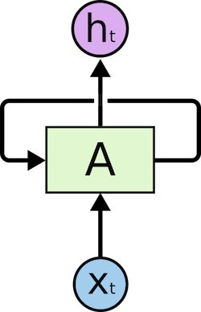
Recurrent Neural Networks
Units contain an aspect of memory, hence they can model dynamics and data that have a time features.
These networks are notoriously difficult to train.
Applications: e.g. Generative processes (building sequences like DNA or video generation)

Slide 87
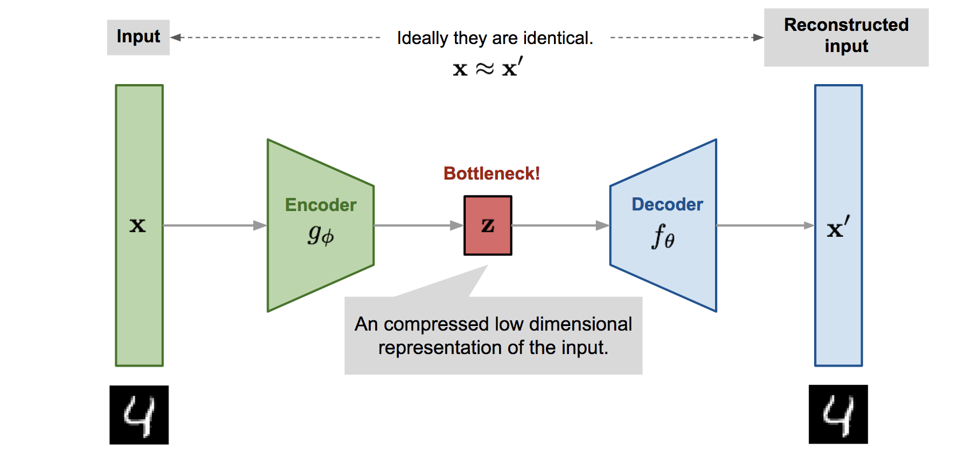
Autoencoders: Condensing data

Slide 88
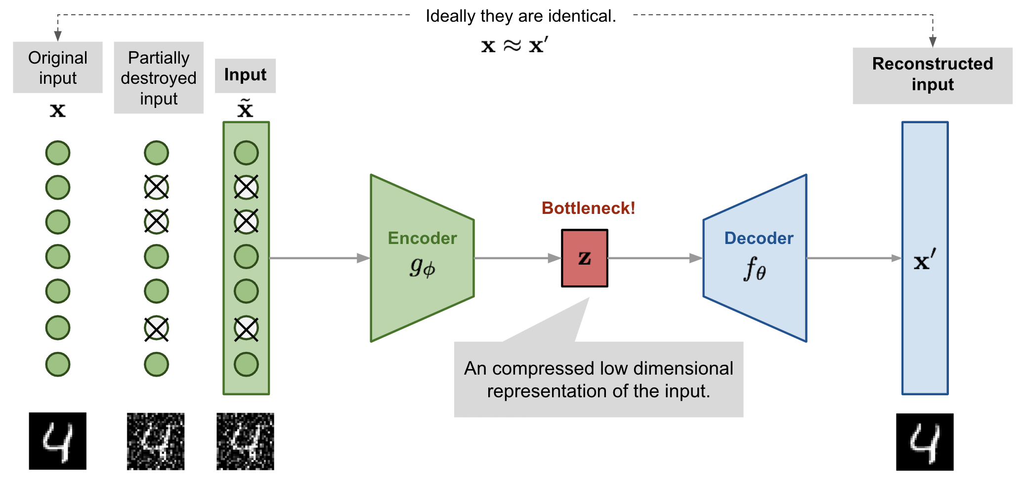
Autoencoders: Decoding noisy data

Slide 89

Generative Adversarial Networks

Slide 90
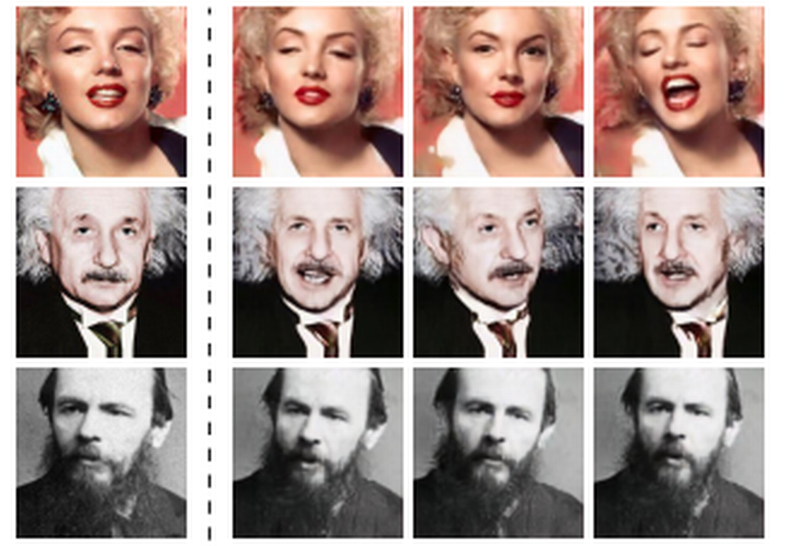
Generative Adversarial Networks

Slide 91
Geometric Deep Learning in Biology

Slide 92
Chemistry/Biology are deeply hierarchical

Slide 93
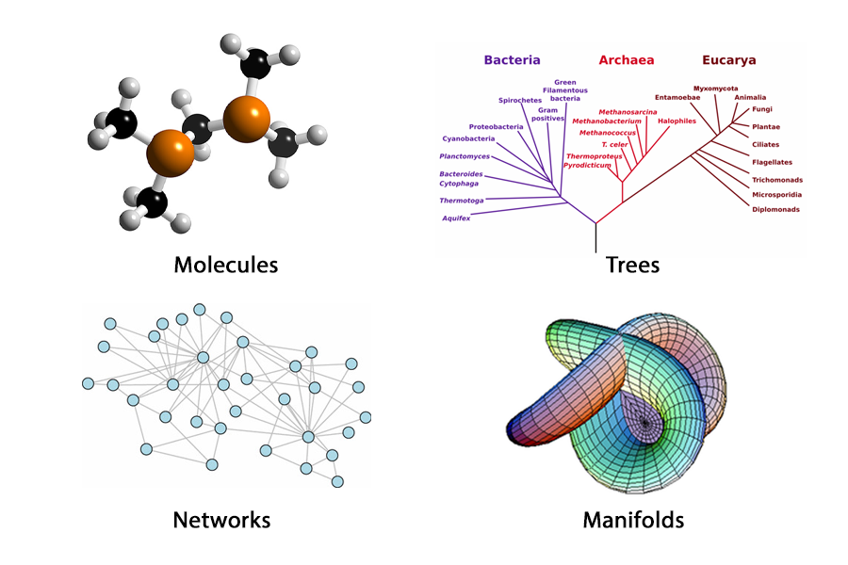
Geometric Deep Learning
Geometric Deep Learning is an exploding field in DL focused on non-Euclidean data

Slide 94
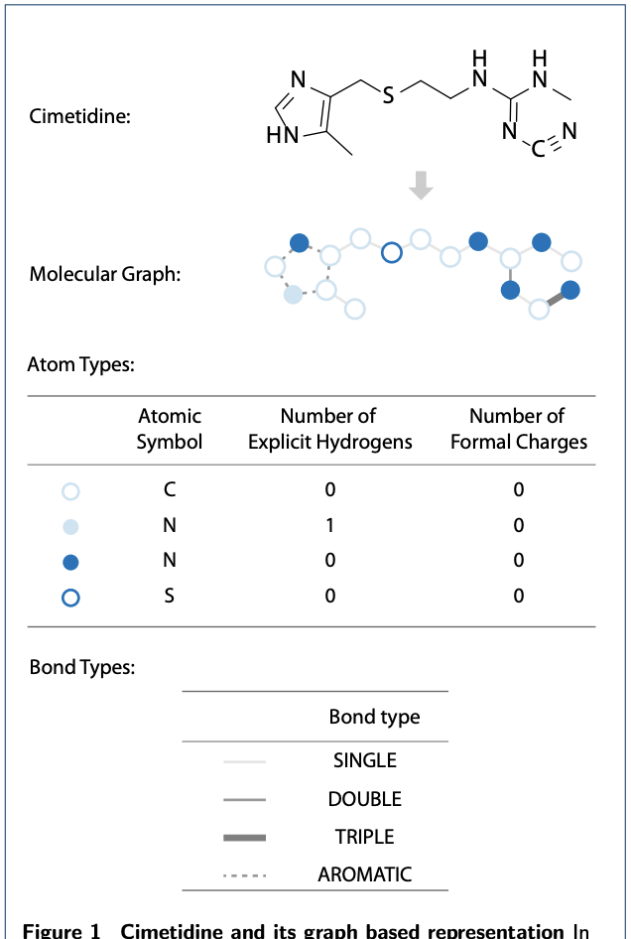
Example: Generative Graph Models for Drug Design
Code: https://github.com/kevinid/molecule_generator

Slide 95
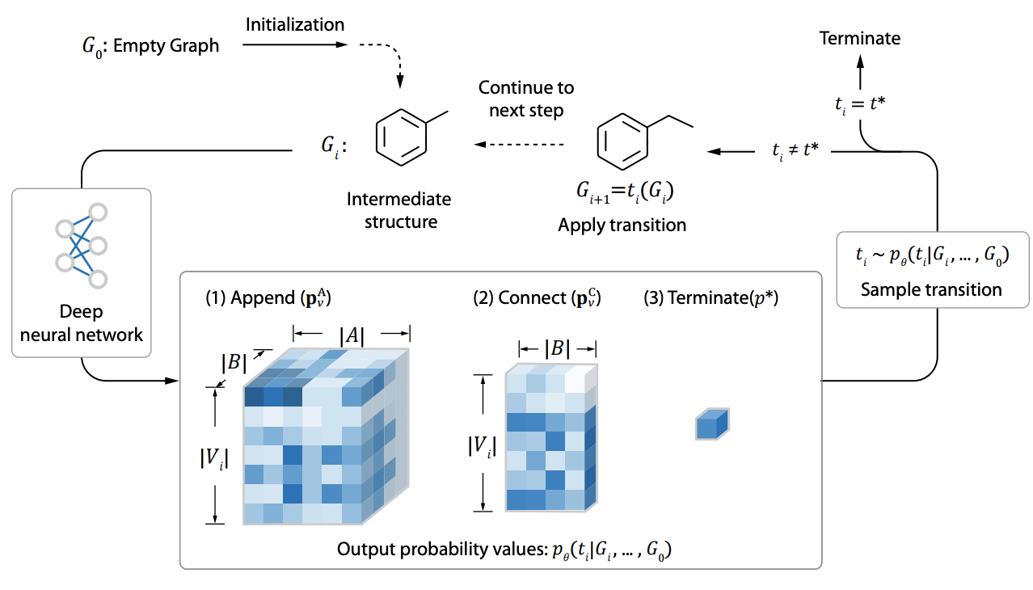
Example: Generative Graph Models for Drug Design

Slide 96
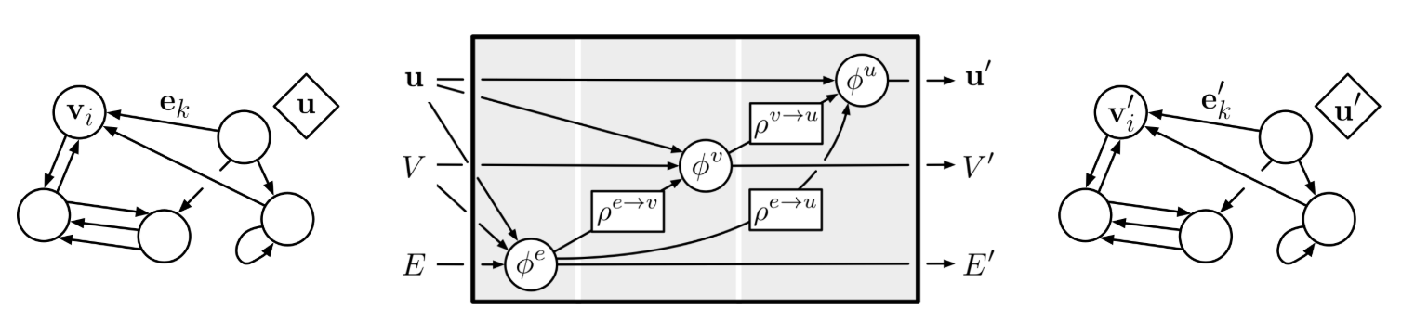
Deep Mind’s Graph Nets Framework
GraphNets is a framework for dealing with graph-like data.
It learns on edge, node, and global graph attributes using the structure of input data.
Similar frameworks include Deep Graph Learning (DGL) and Facebook’s Geometric Pytorch

Slide 97
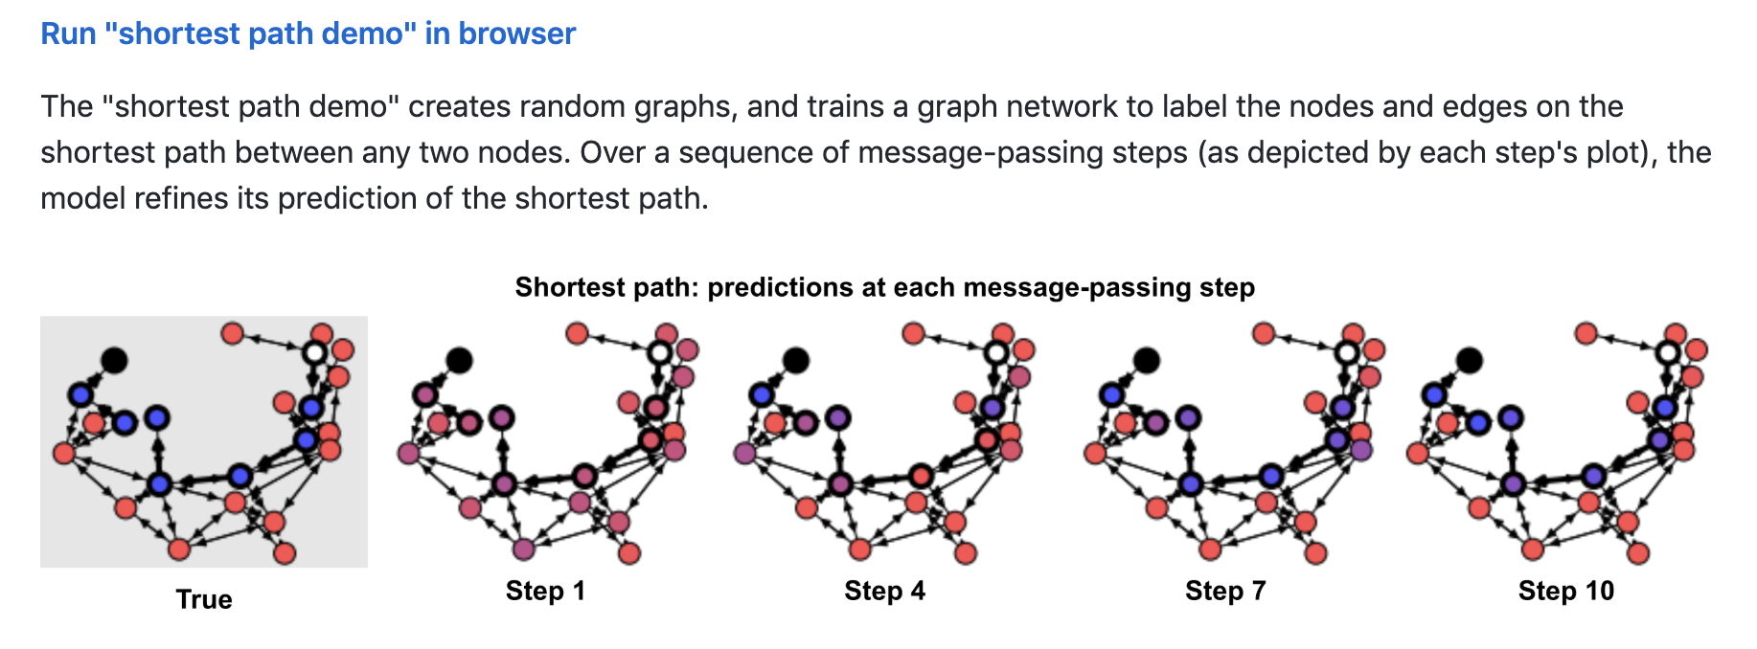
Deep Mind’s Graph Nets Tutorial
https://github.com/deepmind/graph_nets
change num_training_iterations = 500

Slide 98
Group Discussion 2 (~5 min)
How is the shortest path problem formulated? What is the ‘target’ data we are trying to learn? Where is it on the graph?
In the Set up model training and evaluation cell there is a figure of the architecture and discussion of message passing. Can you make any connections with the architectures we previous discussed? [We previously discussed Convolutional, Recurrent, Autoencoders, Generative, Adversarial architectures]
What kinds of problems in biology can you imagine using graph neural networks with?

Slide 99
Examples of Graph Neural Networks in Biology
http://snap.stanford.edu/deepnetbio-ismb/
Gene Function Prediction
Protein-protein interaction prediction
Disease pathway prediction
Drug repurposing
Drug side-effect prediction

Slide 100
TensorFlow/GraphNets Example: Simulating CRNs
How to predict steady state behavior of chemical reaction networks (CRNS) using a graph neural network

Slide 101
Grand Challenge: Machine Design of Cells and Cell Behaviors from ‘Parts’
Image from Jim Collins

Slide 102
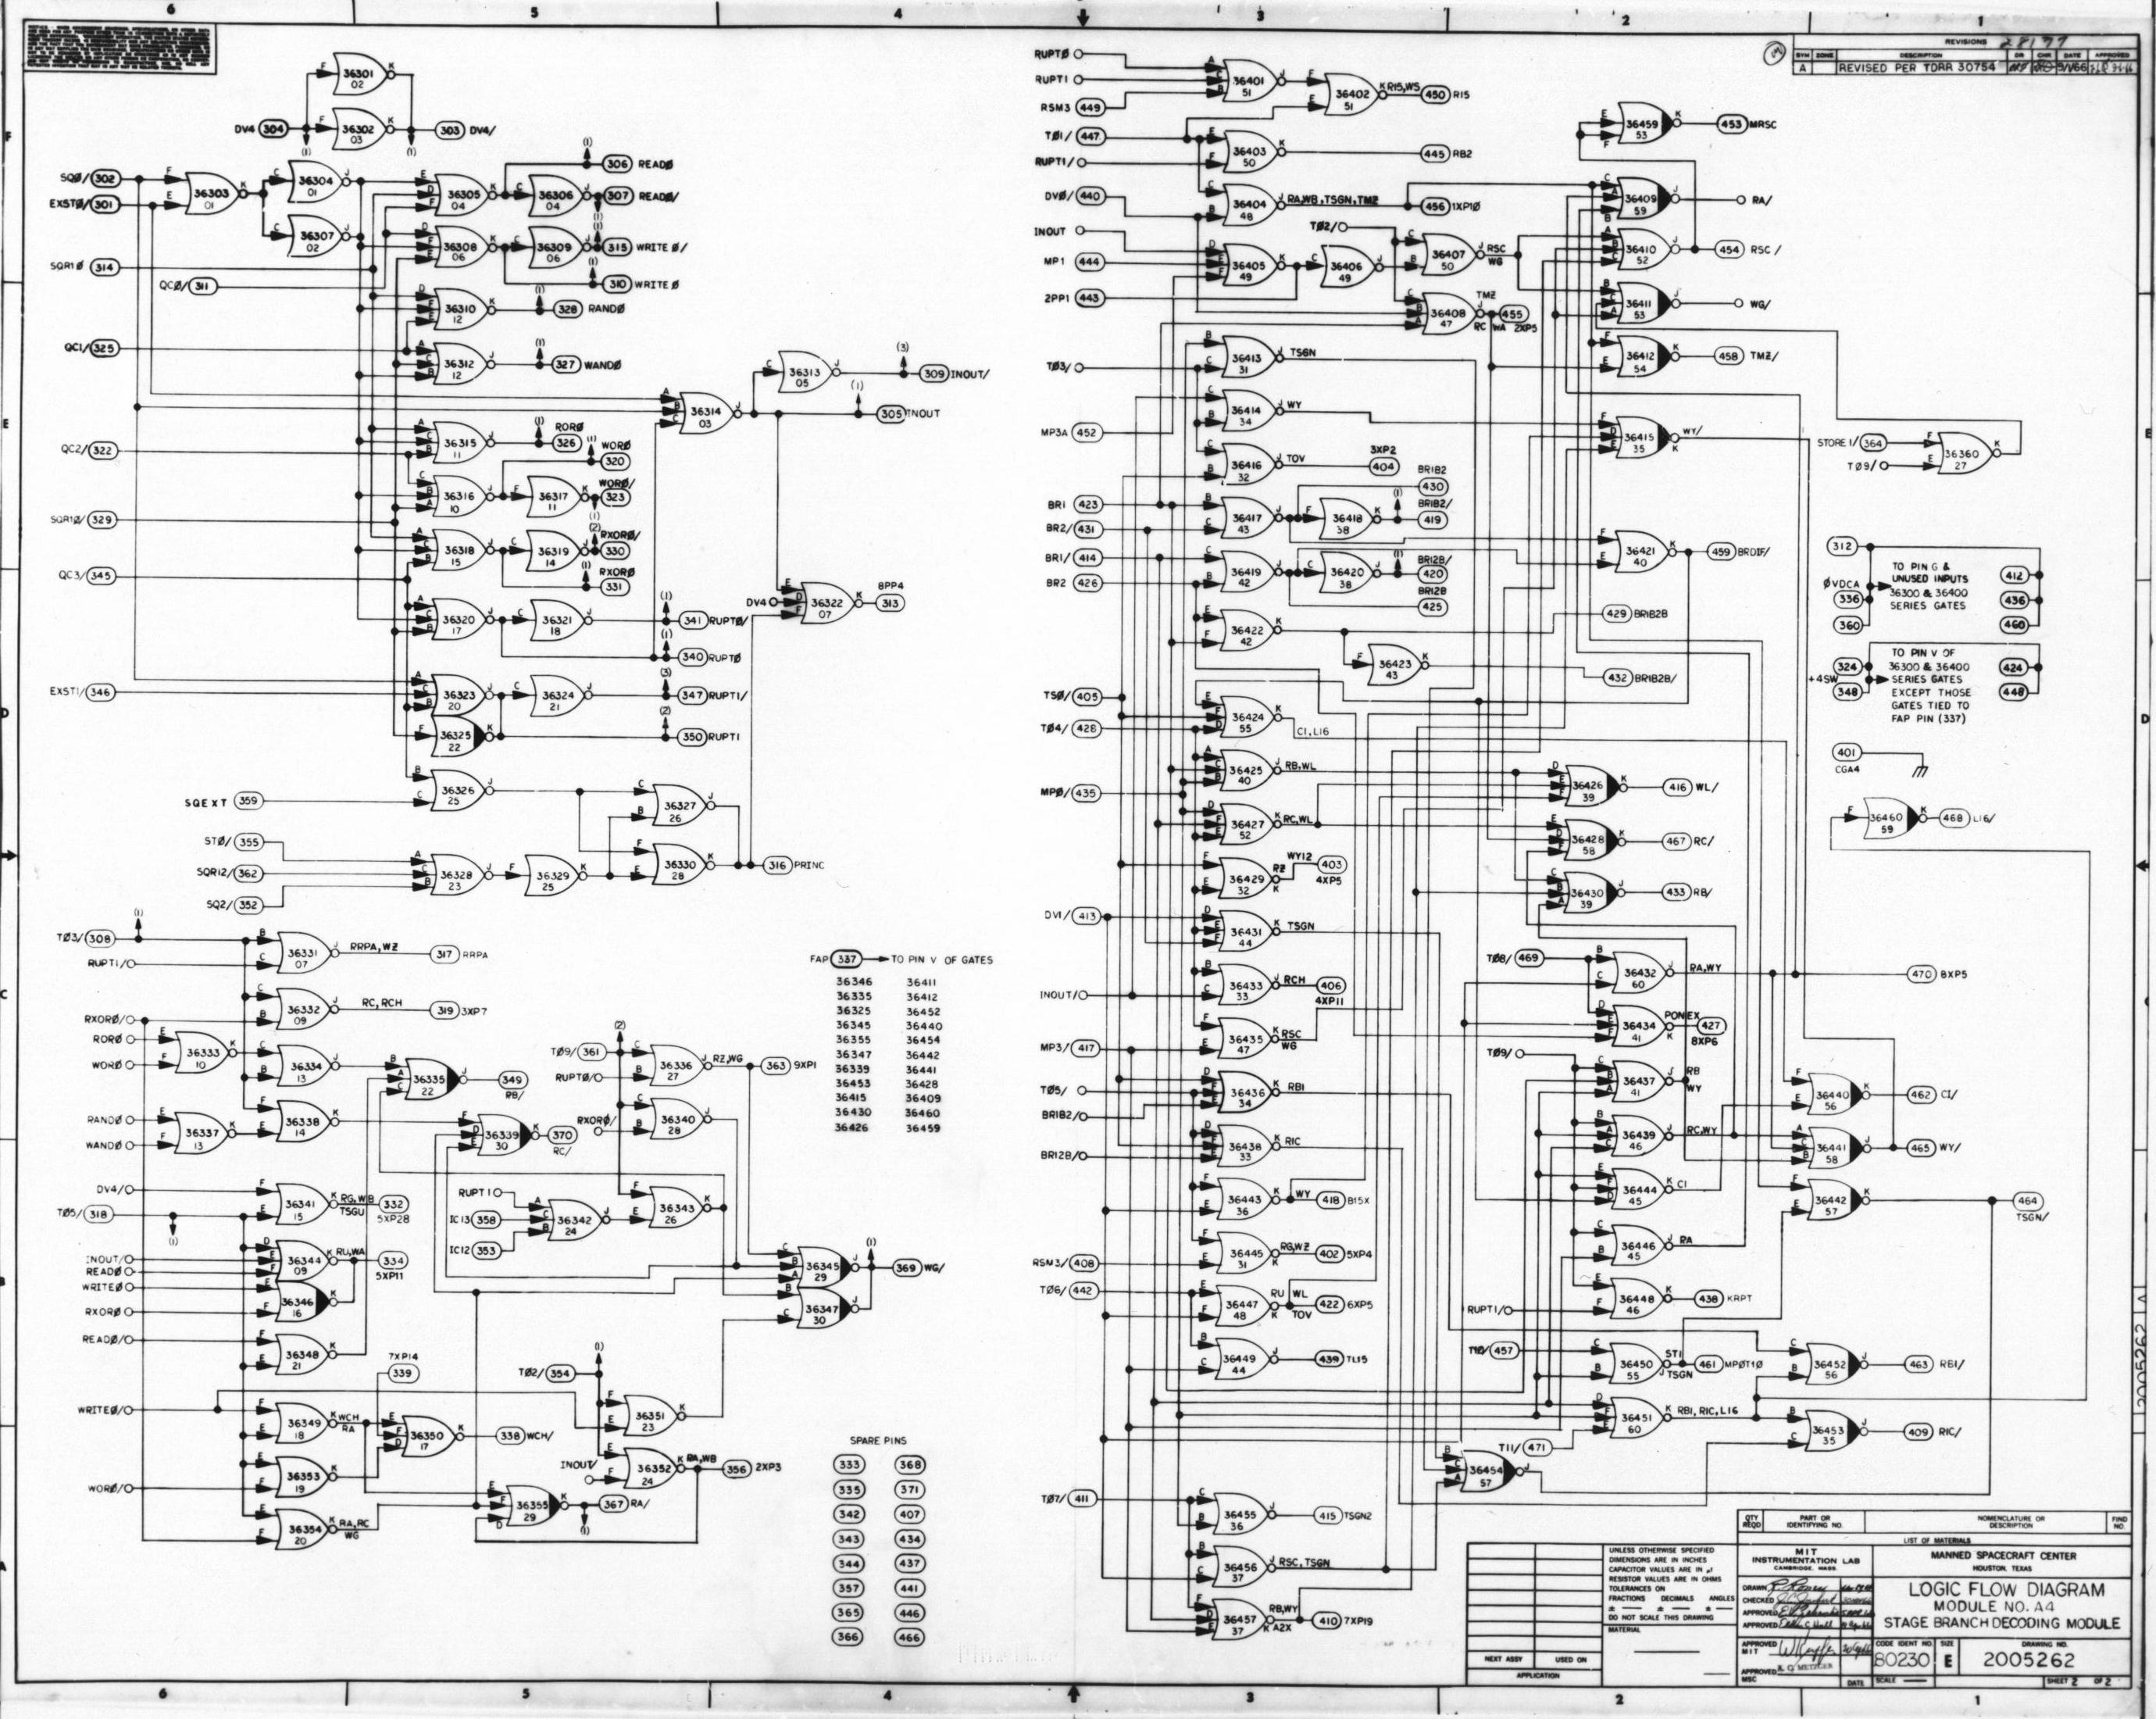
Circuit Composition: NOR Gates Took Us To The Moon
4,100 NOR Gates make up the Apollo Guidance Computer
We will likely need to leverage a machine to help design complex things in cells
http://klabs.org/history/ech/agc_schematics/
Notes:
The Apollo Guidance Computer consisted just of 4,100 NOR gates. This was enough to bring us to the moon and back.

Slide 103
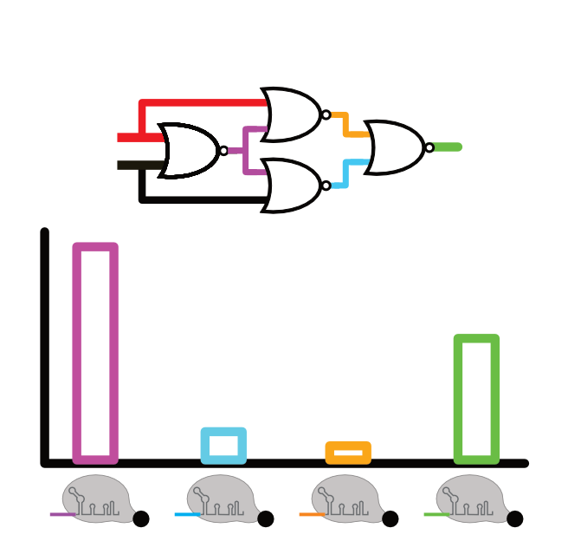
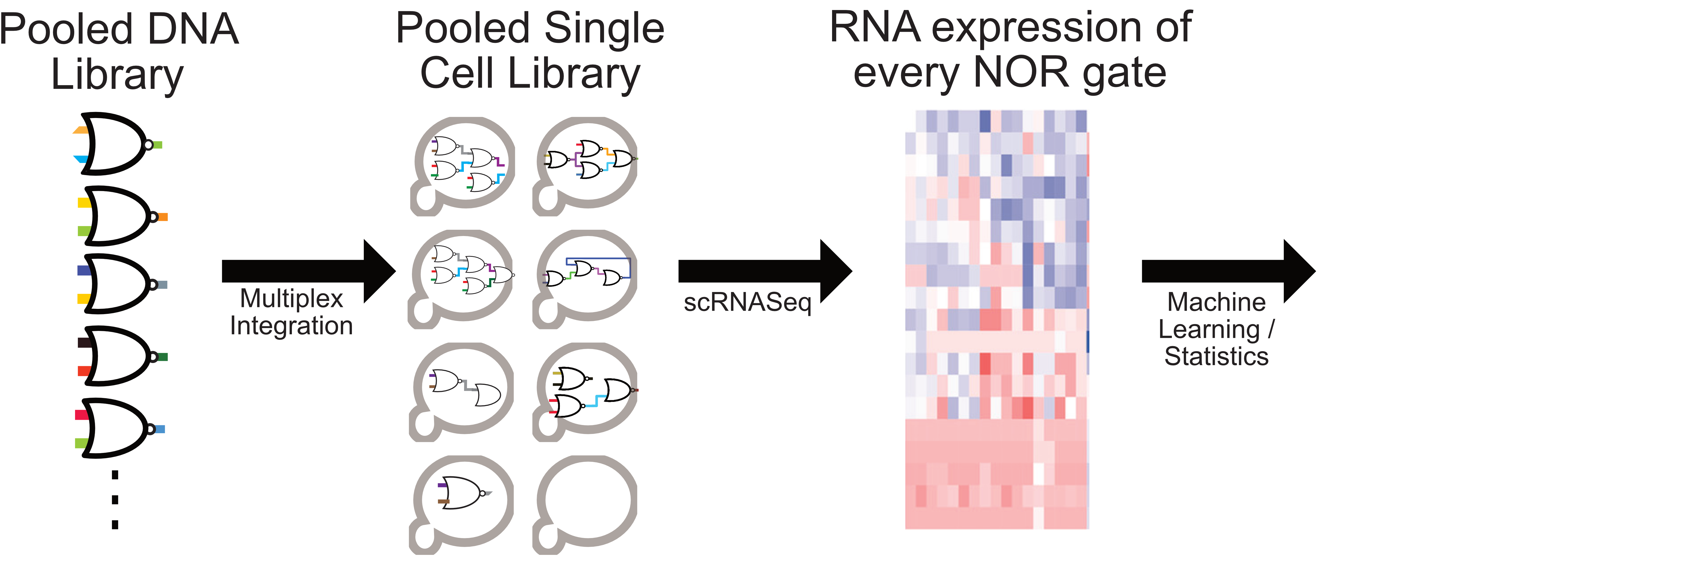
Circuit Prediction Task
Genetic Part Library
Steady State Prediction for Circuits
Expression

Slide 104
Molding our task to GraphNet framework
Graph Nets
Architecture
Our task

Slide 105
Molding our task to GraphNet framework
Graph Nets
Architecture
Many examples of annotated circuits

Slide 106
Generating ’Fake’ Data
Assumptions:
Each genetic part has its own ‘transfer function’ curve based on its identity
Genetic parts output transcripts that may or may not interact with other genetic parts
How these parts interact depend on its sequence features, which may be shared with other parts

Slide 107
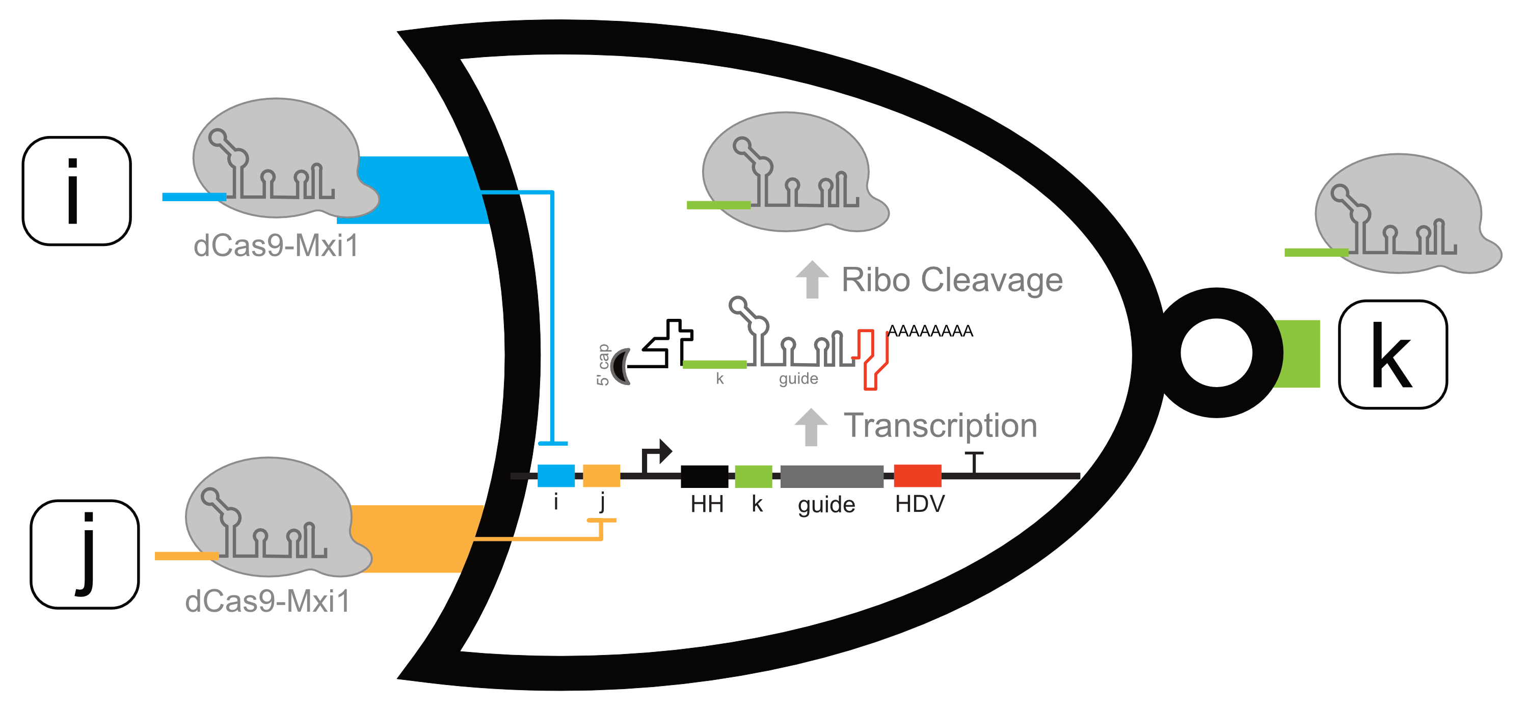
Example: A repressible biological NOR gate

Slide 108
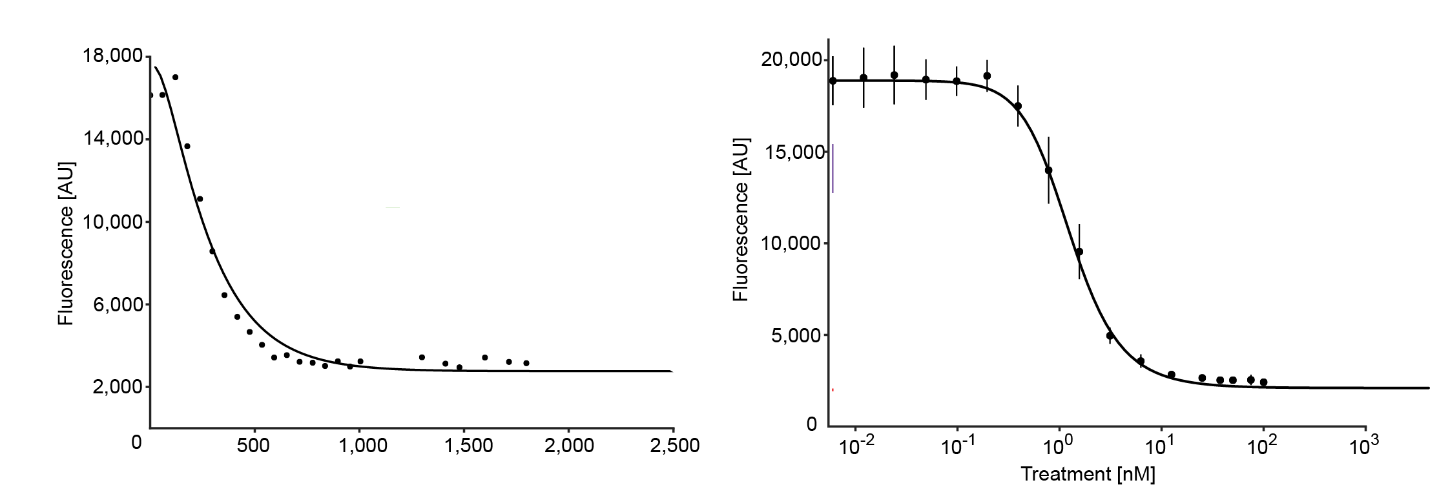

Example: A repressible biological NOR gate

Slide 109

Example: A repressible biological NOR gate
Promoter
...
Guide RNA

Slide 110
Example: A repressible biological NOR gate
input
output

Slide 111

Simulating Random NOR gate library

Slide 112

Converting Circuit Design To Graphs
Real Example:
Save steady state values as node attributes
Graph Repr:

Slide 113
Experimentally, how you would collect such data

Slide 114
TensorFlow / GraphNet Example
This is a WIP, and so code is not as clean as you see in polished tutorials
This will just give you a sense for what actually goes into using these models (thought process, organization, visualization)
https://colab.research.google.com/drive/1ebFxFIxKQ4ySZiwB0lguMVwKYWfxRSo-

Slide 115
CRN Data Generation
Data Generation
Randomized part library created. A function that converted DNA sequence identity to an ODE model was create. Library of 8000 parts created.
Randomized circuits were generated from distribution that seemed plausible given transformation methods.
ODEs were simulated. Steady states estimated. Downselected to 8000 circuits (those circuits that do not have steady-states)
https://github.com/jvrana/pyrxn – my Python CRN simulator
Notes:
Colab forms
GPU
Preprocessing – most code is just forcing data into format NN expects…
Utils - is shuffling important

Slide 116
CRN Simulation Model
Graph Neural Net Model
Architecture:
10 message passing steps (basically limits size of circuits to paths of at most 10 edges)
3 layers for each message passing (2-5 layers work)
400 neurons wide (50-400 works; need sufficient size to memorize parts but small enough to generalize to new circuits)
Learning rate: 1e-4 (trial-and-error, landscape is rough…)
Optimizer: Adam (trial-and-error)
Test/Train Ratio:

Slide 117



CRN Simulation Training: Plotting Expected vs Predicted Values
Training
Notes:
Colab forms
GPU
Preprocessing – most code is just forcing data into format NN expects…
Utils - is shuffling important

Slide 118
CRN Simulation Training
Training: Model learns how ‘repression’ works
Notes:
Colab forms
GPU
Preprocessing – most code is just forcing data into format NN expects…
Utils - is shuffling important

Slide 119
CRN Simulation Training
Training: Eventually learns individual characteristics for each part (i.e. the parameters for the ODE model unique for each component of the NOR gate)
Notes:
Colab forms
GPU
Preprocessing – most code is just forcing data into format NN expects…
Utils - is shuffling important

Slide 120


CRN Predictions (AND gate)
Predicted Expression
Message Passing Steps (Pseudo-time)
Notes:
Colab forms
GPU
Preprocessing – most code is just forcing data into format NN expects…
Utils - is shuffling important

Slide 121

Aside: Data Augmentation
Data augmentation is a technique to create new data from existing data
Improves the generalizability of models and the amount of data

Slide 122
Step for improving the prediction model?
Data Augmentation:
Augment data by pull some nodes to the ‘global’ property. When model is finished, we can ’induce’ the predicted circuits with new guides to understand how they would behave
Notes:
Colab forms
GPU
Preprocessing – most code is just forcing data into format NN expects…
Utils - is shuffling important

Slide 123
WIP: Adding a design aspect
Data Augmentation:
Augment data by pulling a ‘design’ specification. Co-train a generative graph network that can build the circuit from specification
Notes:
Colab forms
GPU
Preprocessing – most code is just forcing data into format NN expects…
Utils - is shuffling important

Slide 124
Grand Challenge Final Discussion
How do you imagine NNs contributing to this grand challenge?
What types of data and features could you envision using
PPI, Protein/DNA/RNA sequences, native transcriptome, Addgene, literature, etc.
Other tasks DL could help solve?
Medicine? Diagnostics? Scientific Communication?

Slide 125



Topics Covered
Deep Learning Basics
Perceptron
Multi-layer perceptron
Forward/Back Propagation
Overfitting/Underfitting
Regularization
Architectures
Conv.,
Recurrent
Generative
Adversarial
Geometric
Frameworks
Examples in Biology
Protein design
Prediction tasks
Lab-of-origin
Drug suggestions
CRN simulation
Other Frameworks

Slide 126
References for Deep Learning
Deep Learning, Ian Goodfellow (2014) [there’s a free online version]
Complete academic reference for deep learning. Includes primer on linear algebra and machine learning
Hands-On Machine Learning with Scikit-Learn & TensorFlow, Aurelien Geron (2017)
https://www.oreilly.com/library/view/hands-on-machine-learning/9781491962282/
The Matrix Cookbook, Pedersen & Petersen (2012)
https://www.math.uwaterloo.ca/~hwolkowi/matrixcookbook.pdf
IntroToDeepLearning.com
MIT course with online material and slides
Online Tutorials:
3Blue1Brown Online Video Series: https://www.youtube.com/playlist?list=PLZHQObOWTQDNU6R1_67000Dx_ZCJB-3pi
Pytorch https://pytorch.org/tutorials/
TensorFlow: https://www.tensorflow.org/tutorials

Slide 127
End Lecture

Slide 129

Biological Circuit Dynamics
Fluorescence vs Time
Fluorescence vs Estradiol
Time (min)
Notes:
Expanding our circuit, we examined the kinetics of a 2-layered NOT gate, seeing that the response time increases substantially on the left and substantially less output on the right.

Slide 130
Biological Implementation: Yeast CRISPR dCas9-Mxi1 Circuits

Slide 131
Biological NOR Gates
Notes:
So knowing the usefulness and flexibility of NOR gates, we set out to create a biological NOR gate for yeast.

Slide 132
Biological Circuit Dynamics
Fluorescence vs Time
Fluorescence vs Estradiol
Time (min)
Notes:
After building Boolean logic circuits, we examined the kinetics to understand the time scales that these circuits operate and their response function. Here we have a beta-estradiol inducible guide RNA hooked up to a NOR gate. One of the inputs is not used, and so we draw it as a triangle, the universal symbol for a NOT gate. Below you’ll see the kinetics on the left and the response function on the right.

Slide 133
Formulating the Design Problem
Want: Neural net that designs cell circuits from a list of parts and goal specification
Need #1: Many varied examples of genetic circuits
Need #2: Extracting goal specifications from genetic circuits

